Slide 1

tile
Notes:
textbox
No alt text provided
image
No alt text provided
textbox
No alt text provided
image
No alt text provided
image
No alt text provided

Slide 2
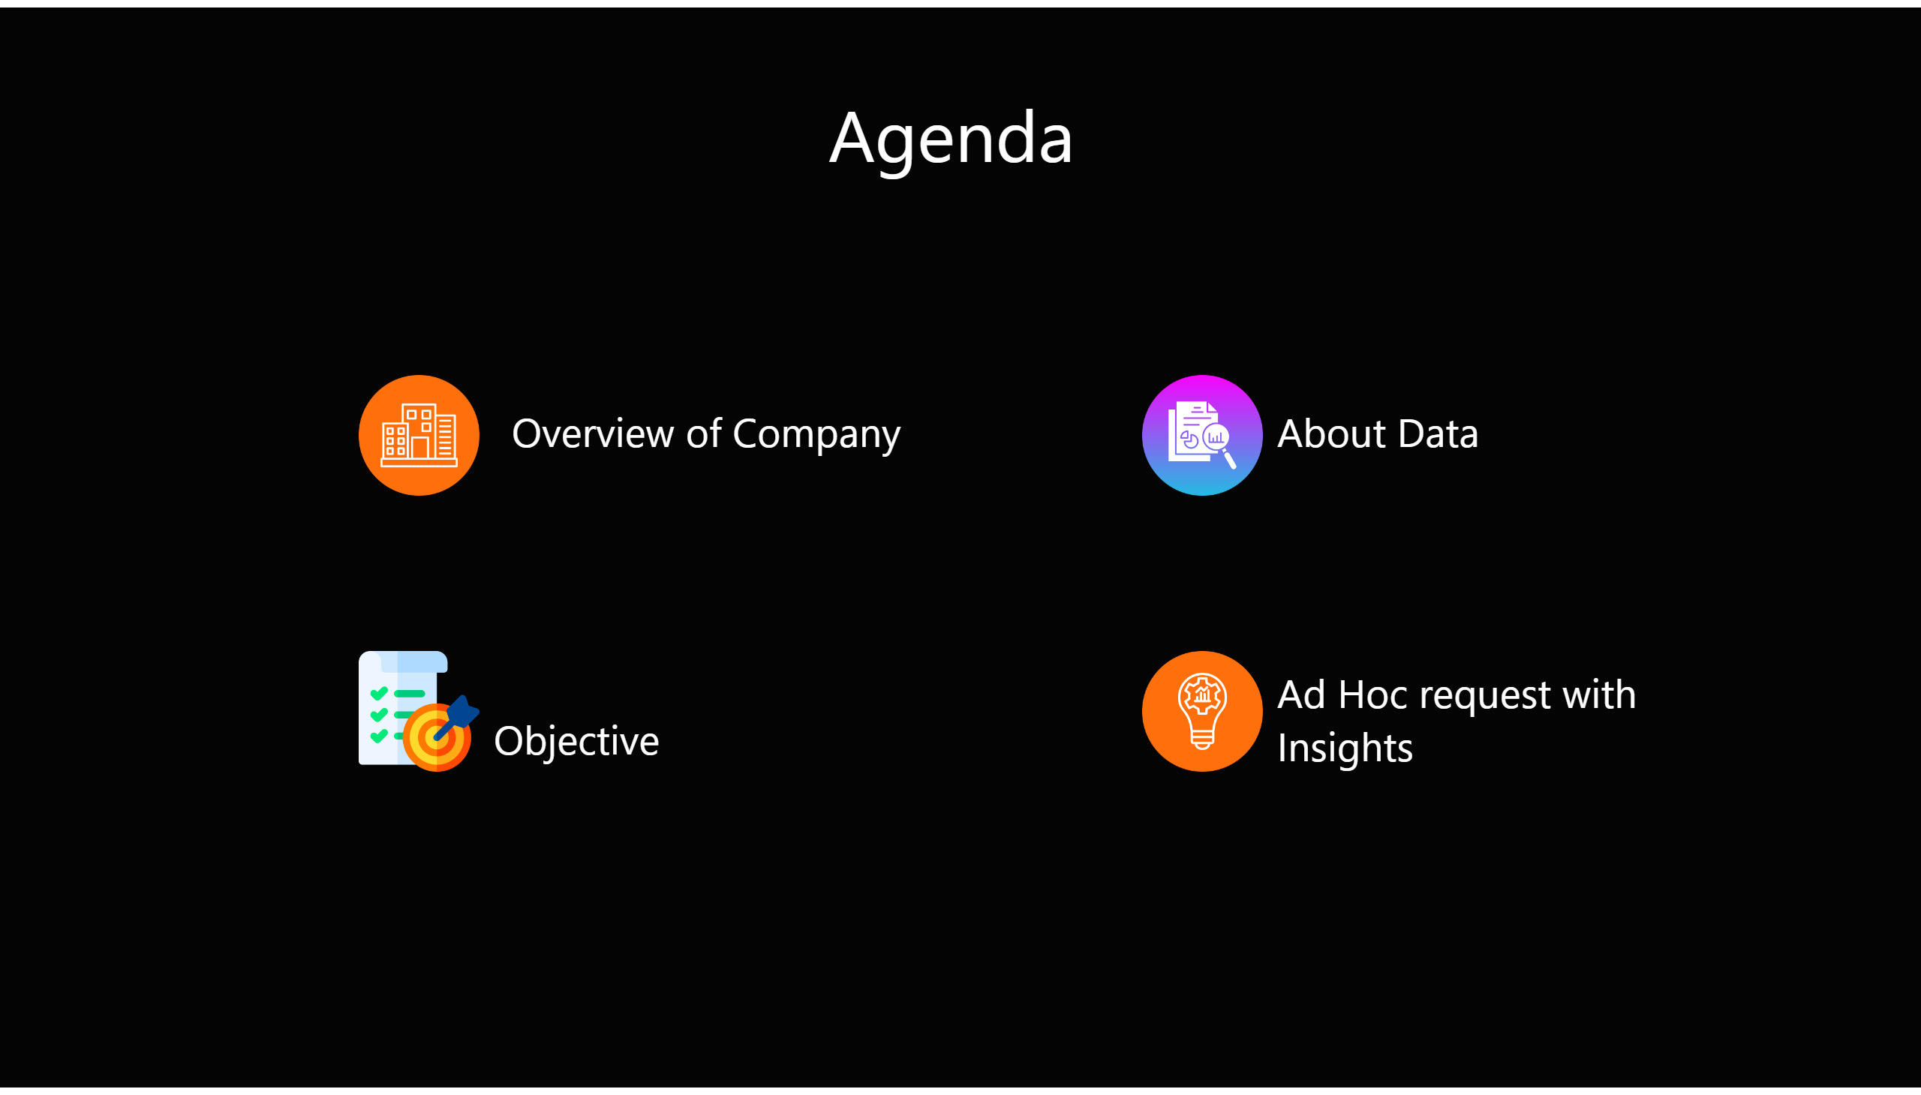
Aggenda
Notes:
shape
No alt text provided
textbox
No alt text provided
textbox
No alt text provided
shape
No alt text provided
shape
No alt text provided
shape
No alt text provided
textbox
No alt text provided
shape
No alt text provided
textbox
No alt text provided
shape
No alt text provided
textbox
No alt text provided
shape
No alt text provided
shape
No alt text provided
shape
No alt text provided
textbox
No alt text provided
textbox
No alt text provided
shape
No alt text provided
textbox
No alt text provided
textbox
No alt text provided
shape
No alt text provided
textbox
No alt text provided
image
No alt text provided
image
No alt text provided
image
No alt text provided
image
No alt text provided
textbox
No alt text provided
textbox
No alt text provided
textbox
No alt text provided
textbox
No alt text provided

Slide 3

company
Notes:
shape
No alt text provided
textbox
No alt text provided
textbox
No alt text provided
shape
No alt text provided
shape
No alt text provided
shape
No alt text provided
textbox
No alt text provided
shape
No alt text provided
textbox
No alt text provided
shape
No alt text provided
textbox
No alt text provided
shape
No alt text provided
shape
No alt text provided
shape
No alt text provided
textbox
No alt text provided
textbox
No alt text provided
shape
No alt text provided
textbox
No alt text provided
textbox
No alt text provided
shape
No alt text provided
image
No alt text provided
textbox
No alt text provided

Slide 4
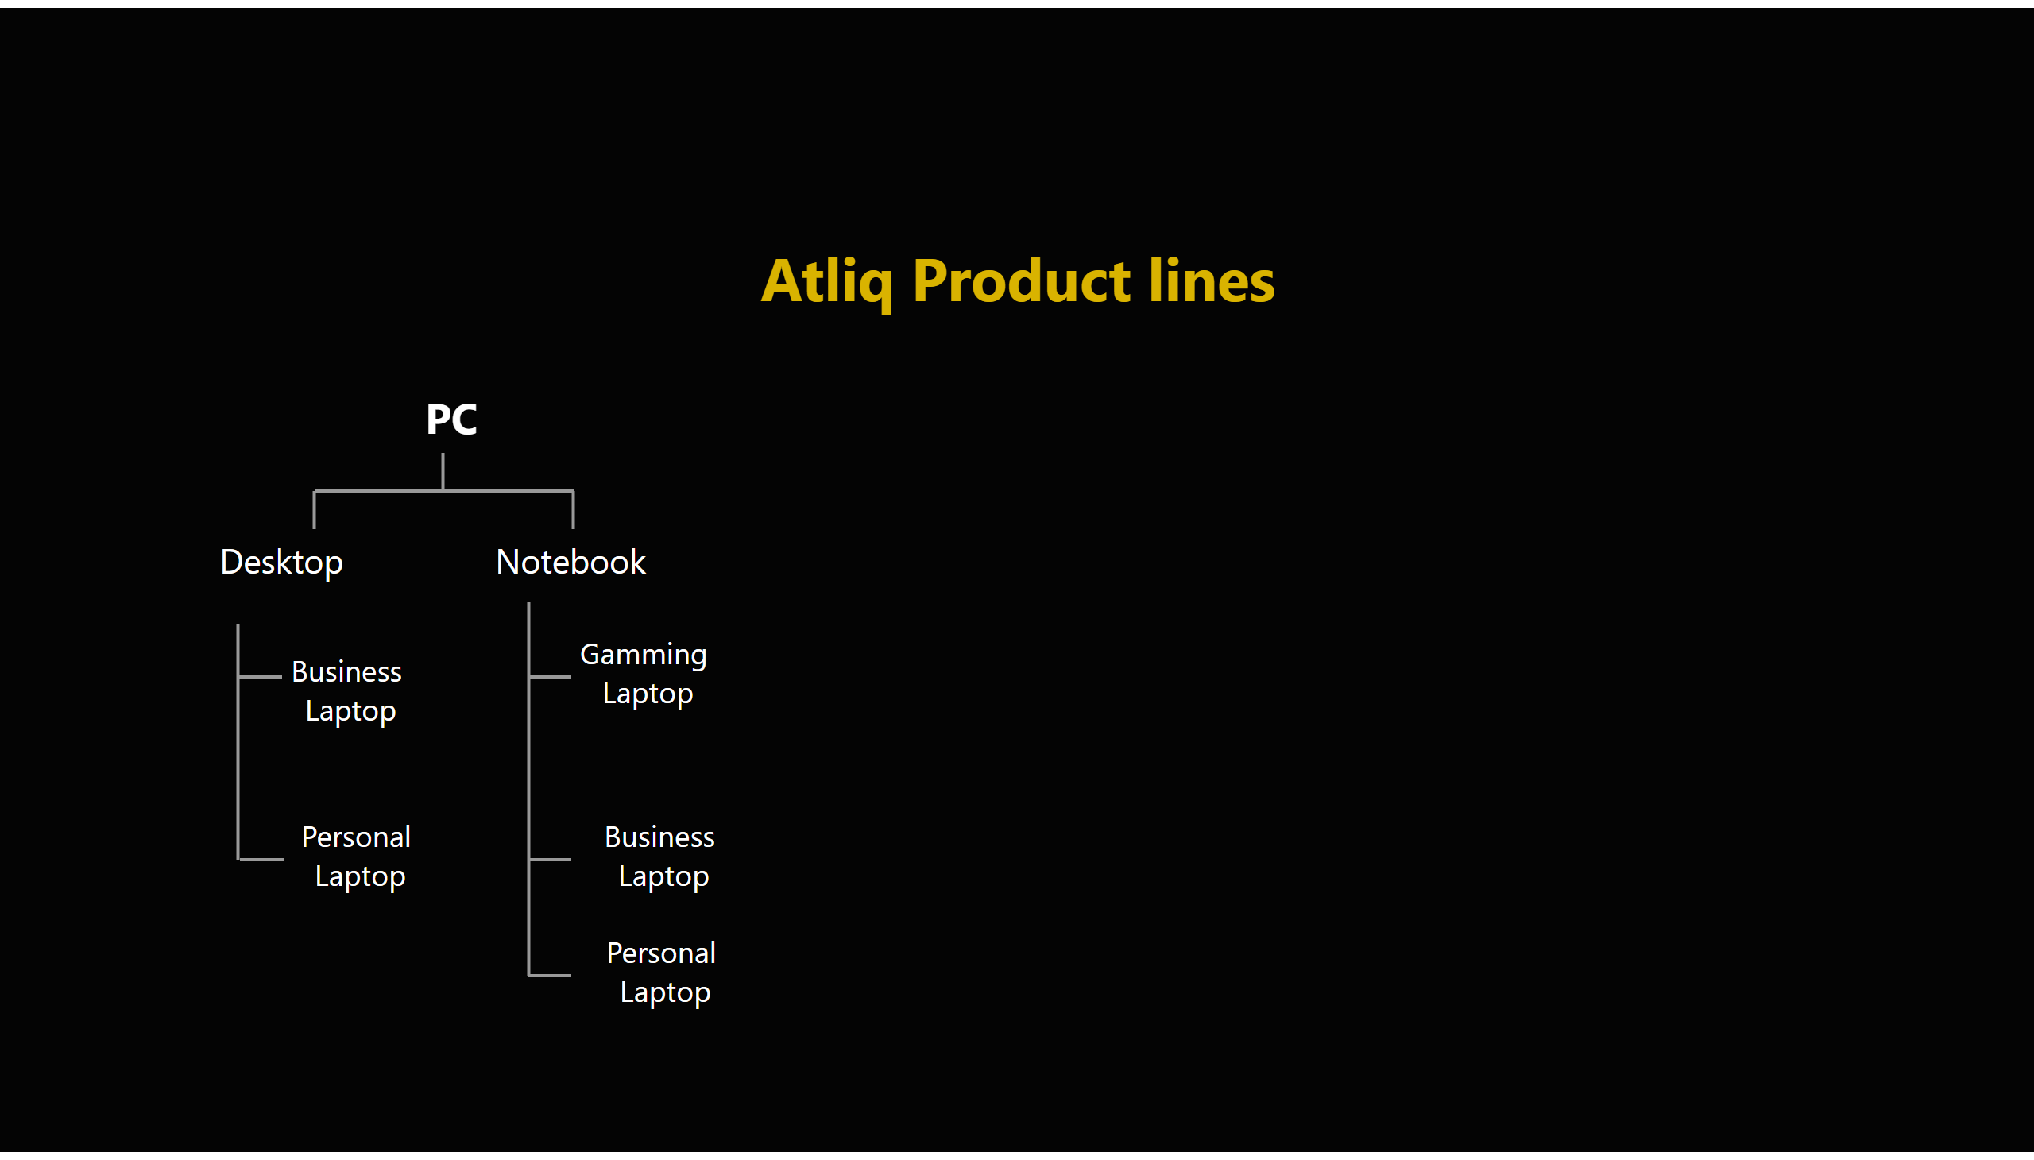
page2
Notes:
textbox
No alt text provided
shape
No alt text provided
textbox
No alt text provided
shape
No alt text provided
shape
No alt text provided
shape
No alt text provided
textbox
No alt text provided
shape
No alt text provided
textbox
No alt text provided
shape
No alt text provided
textbox
No alt text provided
shape
No alt text provided
shape
No alt text provided
shape
No alt text provided
textbox
No alt text provided
textbox
No alt text provided
shape
No alt text provided
textbox
No alt text provided
shape
No alt text provided
textbox
No alt text provided
shape
No alt text provided
textbox
No alt text provided
textbox
No alt text provided
shape
No alt text provided
shape
No alt text provided
shape
No alt text provided
textbox
No alt text provided
shape
No alt text provided
textbox
No alt text provided
shape
No alt text provided
textbox
No alt text provided
shape
No alt text provided
shape
No alt text provided
shape
No alt text provided
textbox
No alt text provided
textbox
No alt text provided
shape
No alt text provided
textbox
No alt text provided
textbox
No alt text provided
shape
No alt text provided

Slide 5
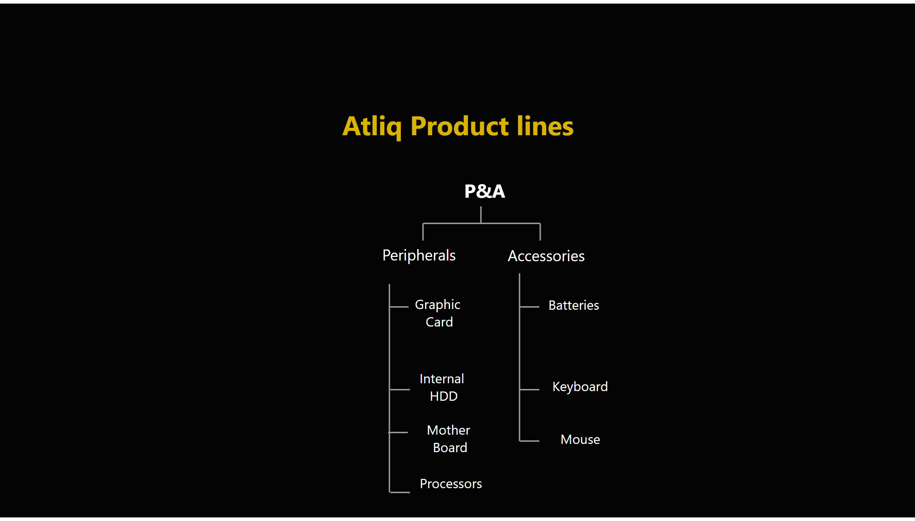
page3
Notes:
textbox
No alt text provided
shape
No alt text provided
textbox
No alt text provided
shape
No alt text provided
shape
No alt text provided
shape
No alt text provided
textbox
No alt text provided
shape
No alt text provided
textbox
No alt text provided
shape
No alt text provided
textbox
No alt text provided
shape
No alt text provided
shape
No alt text provided
shape
No alt text provided
textbox
No alt text provided
textbox
No alt text provided
shape
No alt text provided
textbox
No alt text provided
shape
No alt text provided
textbox
No alt text provided
shape
No alt text provided
textbox
No alt text provided
shape
No alt text provided
shape
No alt text provided
shape
No alt text provided
textbox
No alt text provided
shape
No alt text provided
textbox
No alt text provided
shape
No alt text provided
textbox
No alt text provided
shape
No alt text provided
shape
No alt text provided
shape
No alt text provided
textbox
No alt text provided
textbox
No alt text provided
shape
No alt text provided
textbox
No alt text provided
shape
No alt text provided
textbox
No alt text provided
shape
No alt text provided
textbox
No alt text provided
textbox
No alt text provided
shape
No alt text provided

Slide 6
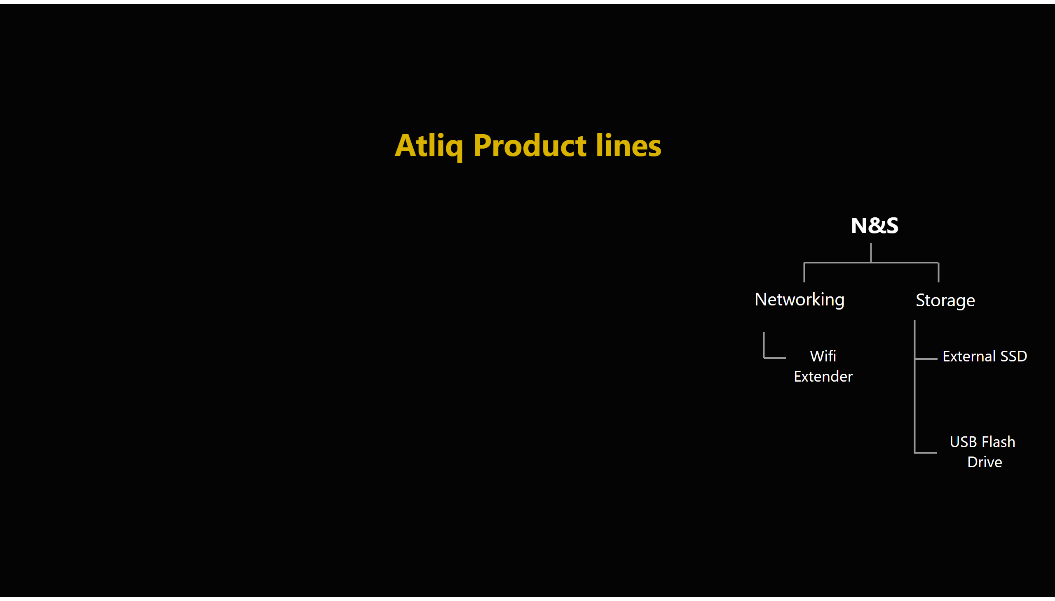
page4
Notes:
textbox
No alt text provided
shape
No alt text provided
textbox
No alt text provided
textbox
No alt text provided
shape
No alt text provided
shape
No alt text provided
shape
No alt text provided
textbox
No alt text provided
shape
No alt text provided
textbox
No alt text provided
shape
No alt text provided
textbox
No alt text provided
shape
No alt text provided
shape
No alt text provided
shape
No alt text provided
textbox
No alt text provided
textbox
No alt text provided
shape
No alt text provided
textbox
No alt text provided
shape
No alt text provided
textbox
No alt text provided
shape
No alt text provided
textbox
No alt text provided
shape
No alt text provided
shape
No alt text provided
shape
No alt text provided
textbox
No alt text provided
shape
No alt text provided
textbox
No alt text provided
shape
No alt text provided
textbox
No alt text provided
shape
No alt text provided
shape
No alt text provided
shape
No alt text provided
textbox
No alt text provided
textbox
No alt text provided
shape
No alt text provided
textbox
No alt text provided
shape
No alt text provided
textbox
No alt text provided
shape
No alt text provided
textbox
No alt text provided
shape
No alt text provided
shape
No alt text provided
textbox
No alt text provided
shape
No alt text provided
shape
No alt text provided
shape
No alt text provided
textbox
No alt text provided
shape
No alt text provided
textbox
No alt text provided
shape
No alt text provided
shape
No alt text provided
shape
No alt text provided
textbox
No alt text provided
textbox
No alt text provided
shape
No alt text provided
textbox
No alt text provided

Slide 7
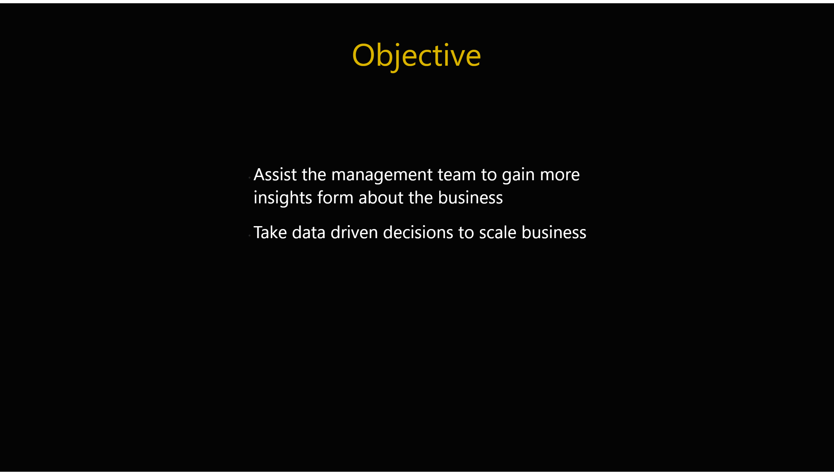
objective
Notes:
shape
No alt text provided
textbox
No alt text provided
textbox
No alt text provided
shape
No alt text provided
shape
No alt text provided
shape
No alt text provided
textbox
No alt text provided
shape
No alt text provided
textbox
No alt text provided
shape
No alt text provided
textbox
No alt text provided
shape
No alt text provided
shape
No alt text provided
shape
No alt text provided
textbox
No alt text provided
textbox
No alt text provided
shape
No alt text provided
textbox
No alt text provided
textbox
No alt text provided
shape
No alt text provided
textbox
No alt text provided
textbox
No alt text provided

Slide 8
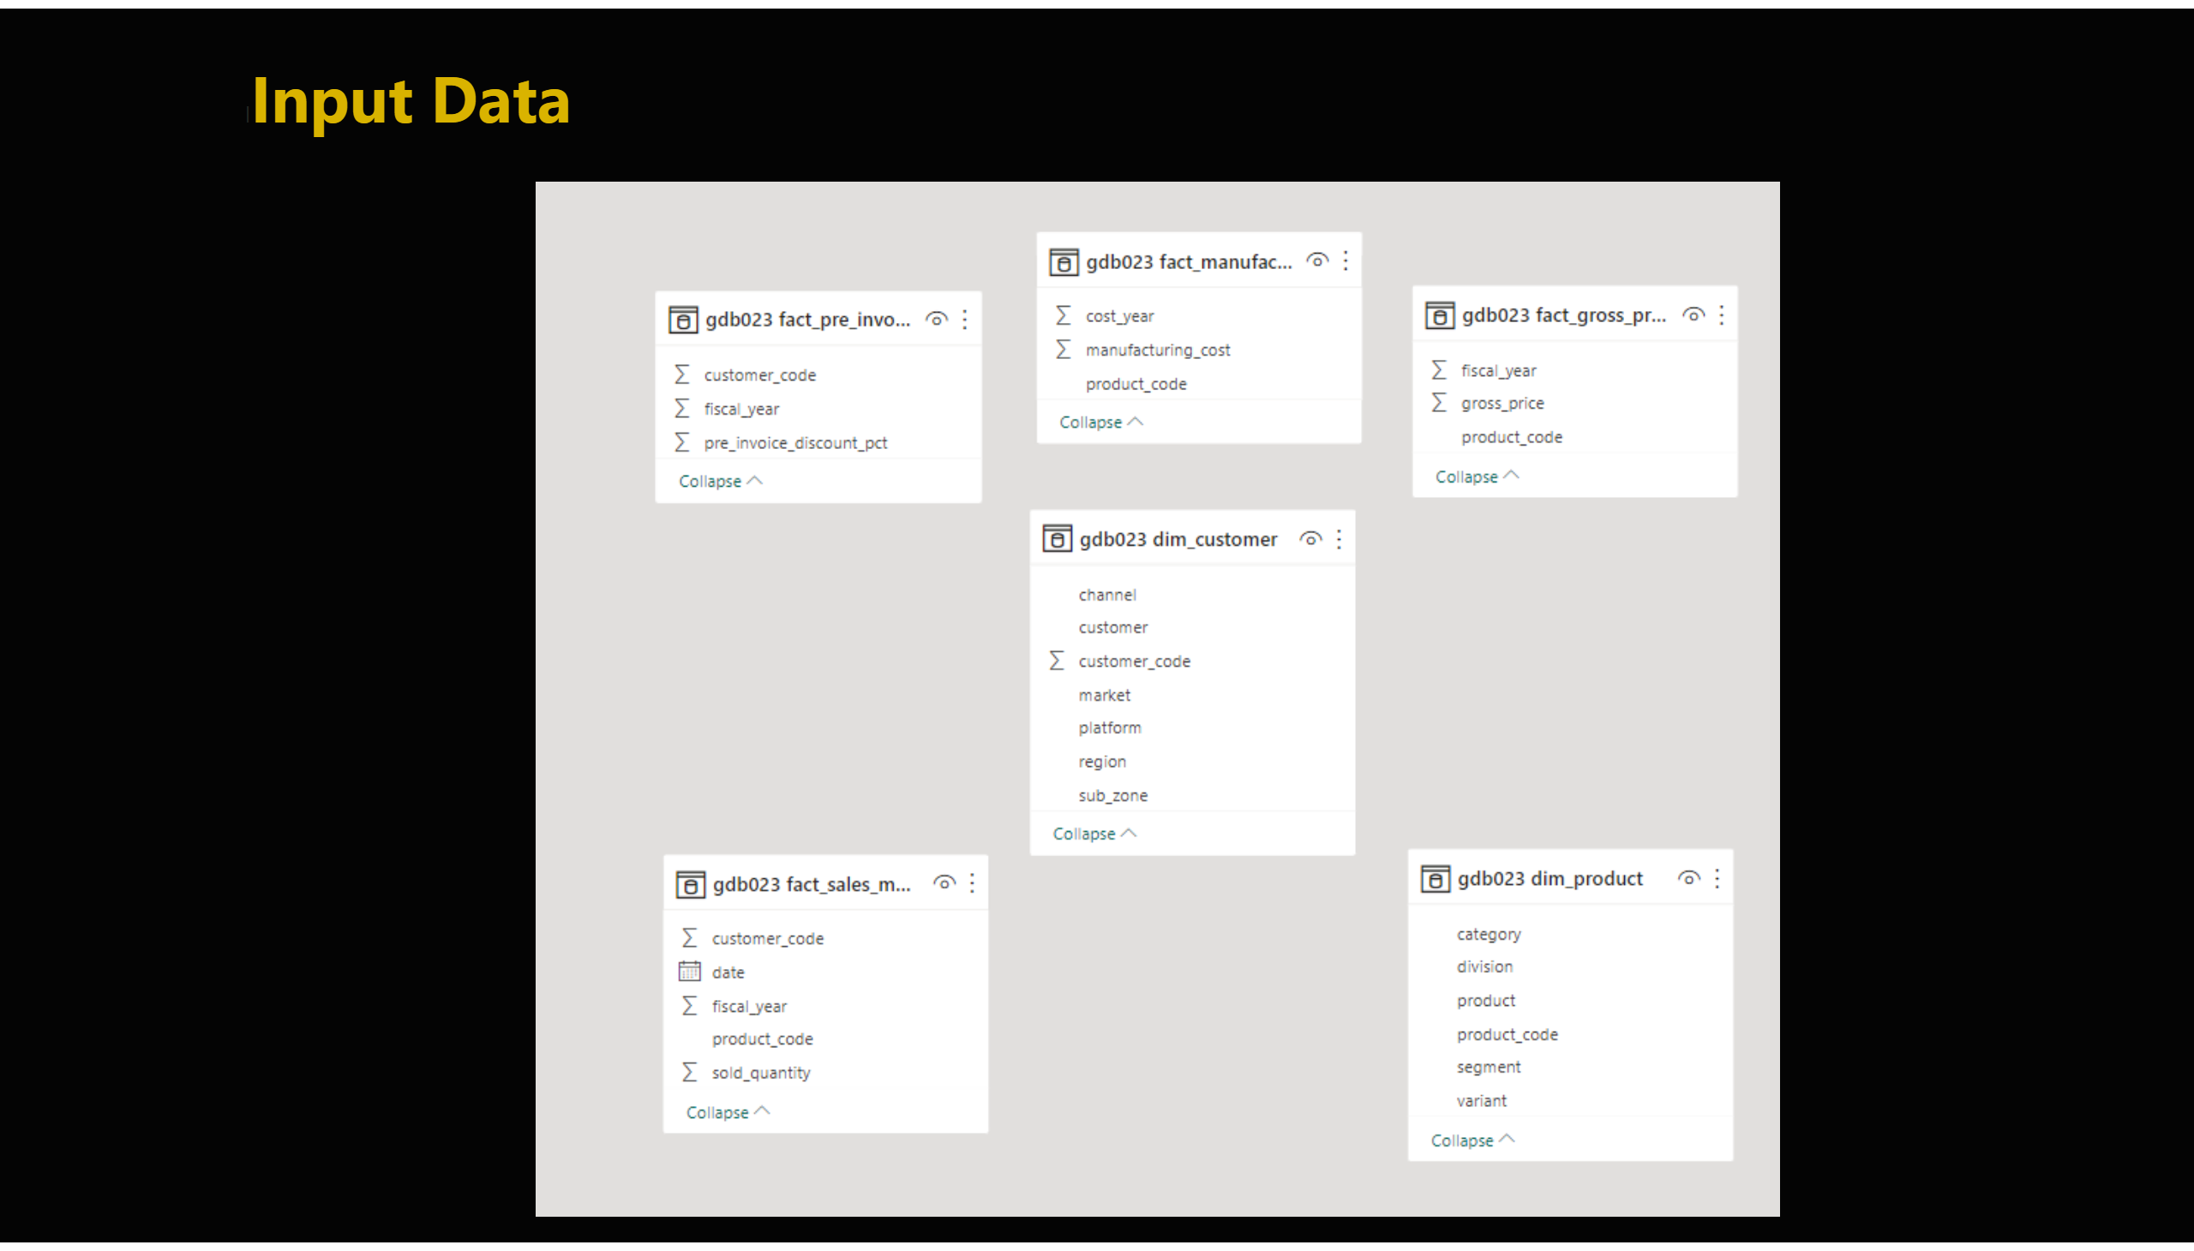
database
Notes:
textbox
No alt text provided
image
No alt text provided

Slide 9

request
Notes:
shape
No alt text provided
textbox
No alt text provided
textbox
No alt text provided
shape
No alt text provided
shape
No alt text provided
shape
No alt text provided
textbox
No alt text provided
shape
No alt text provided
textbox
No alt text provided
shape
No alt text provided
textbox
No alt text provided
shape
No alt text provided
shape
No alt text provided
shape
No alt text provided
textbox
No alt text provided
textbox
No alt text provided
shape
No alt text provided
textbox
No alt text provided
textbox
No alt text provided
shape
No alt text provided
textbox
No alt text provided

Slide 10

1
Notes:
shape
No alt text provided
textbox
No alt text provided
textbox
No alt text provided
shape
No alt text provided

Slide 11
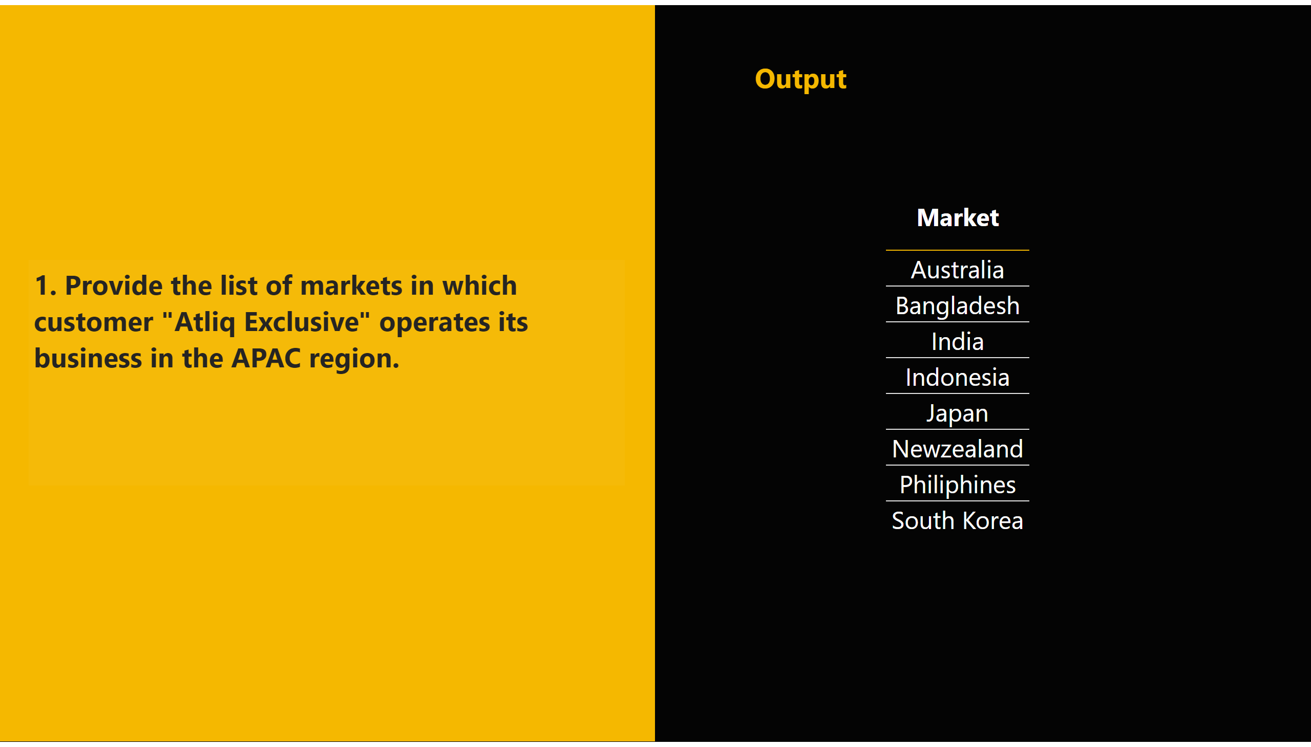
A1
Notes:
shape
No alt text provided
tableEx
No alt text provided
textbox
No alt text provided
textbox
No alt text provided
shape
No alt text provided

Slide 12
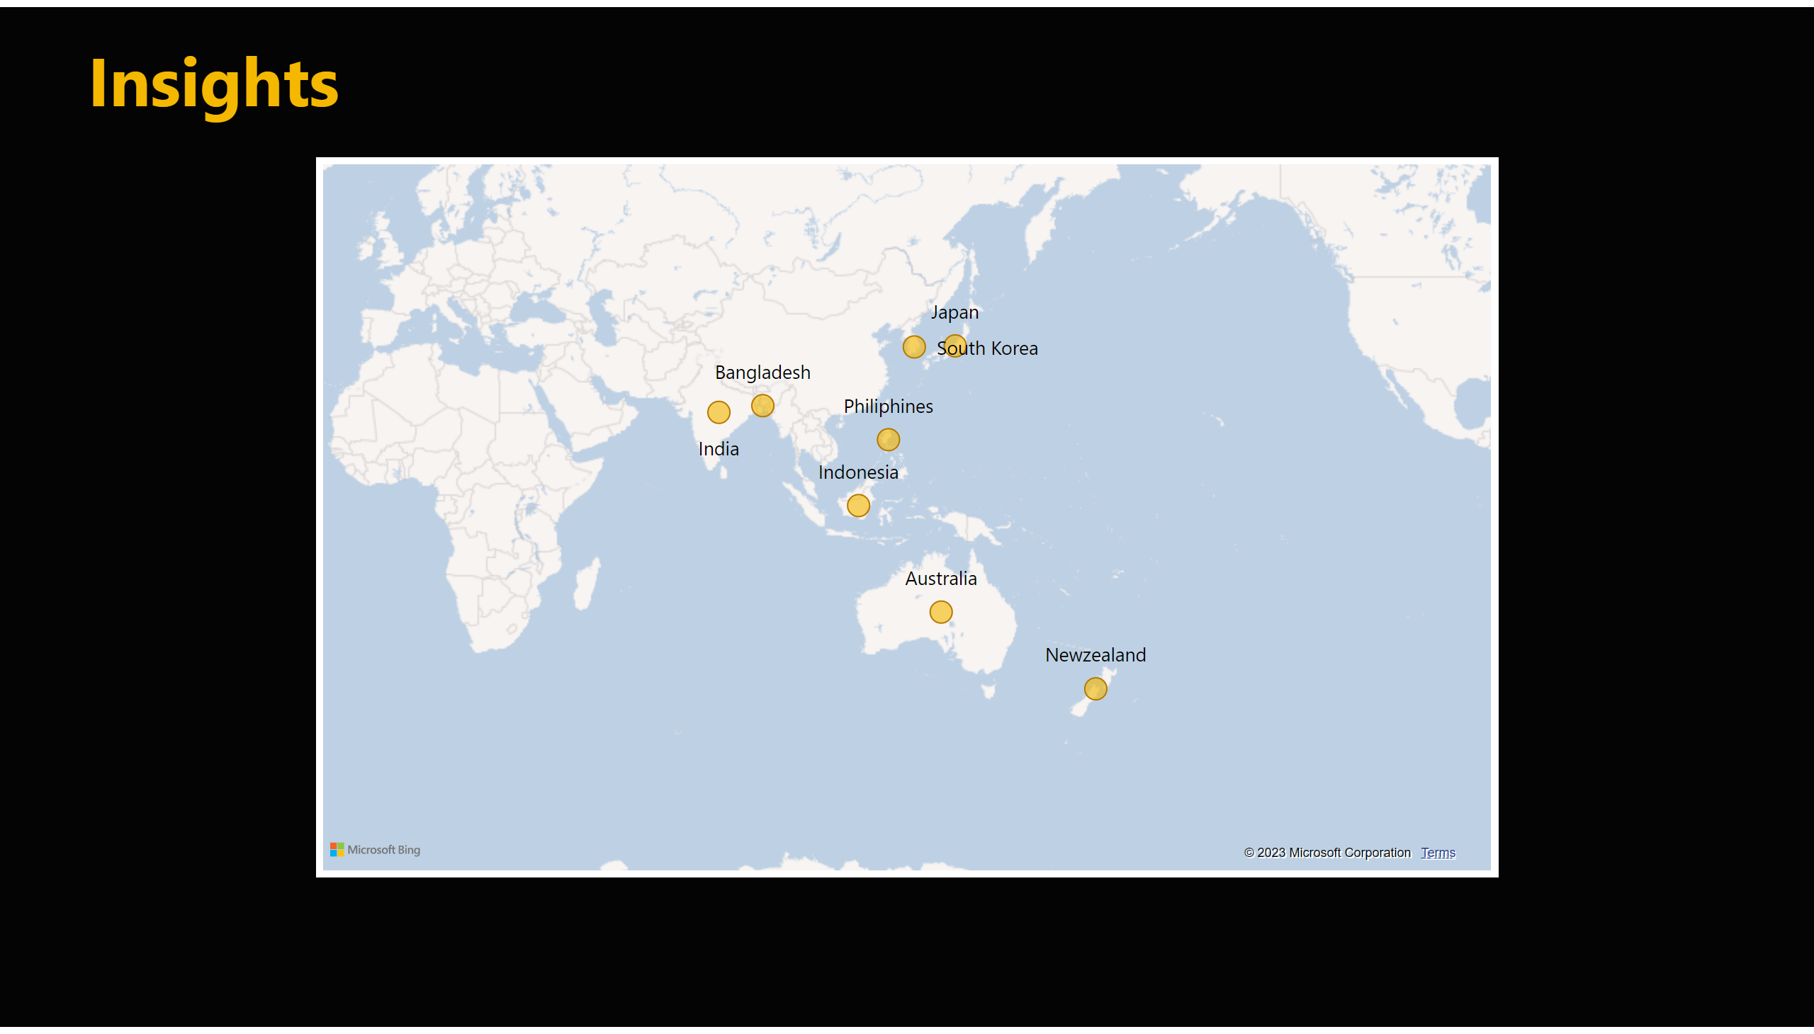
request1
Notes:
map
No alt text provided
textbox
No alt text provided

Slide 13
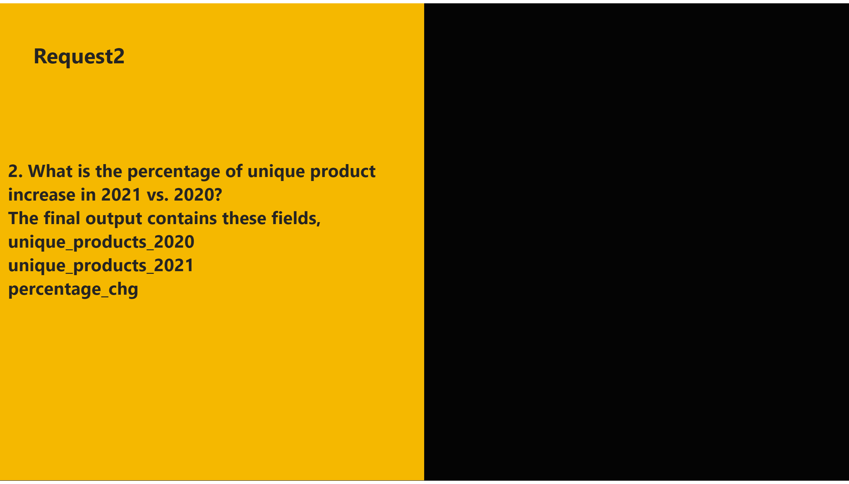
2
Notes:
shape
No alt text provided
textbox
No alt text provided
textbox
No alt text provided
shape
No alt text provided

Slide 14
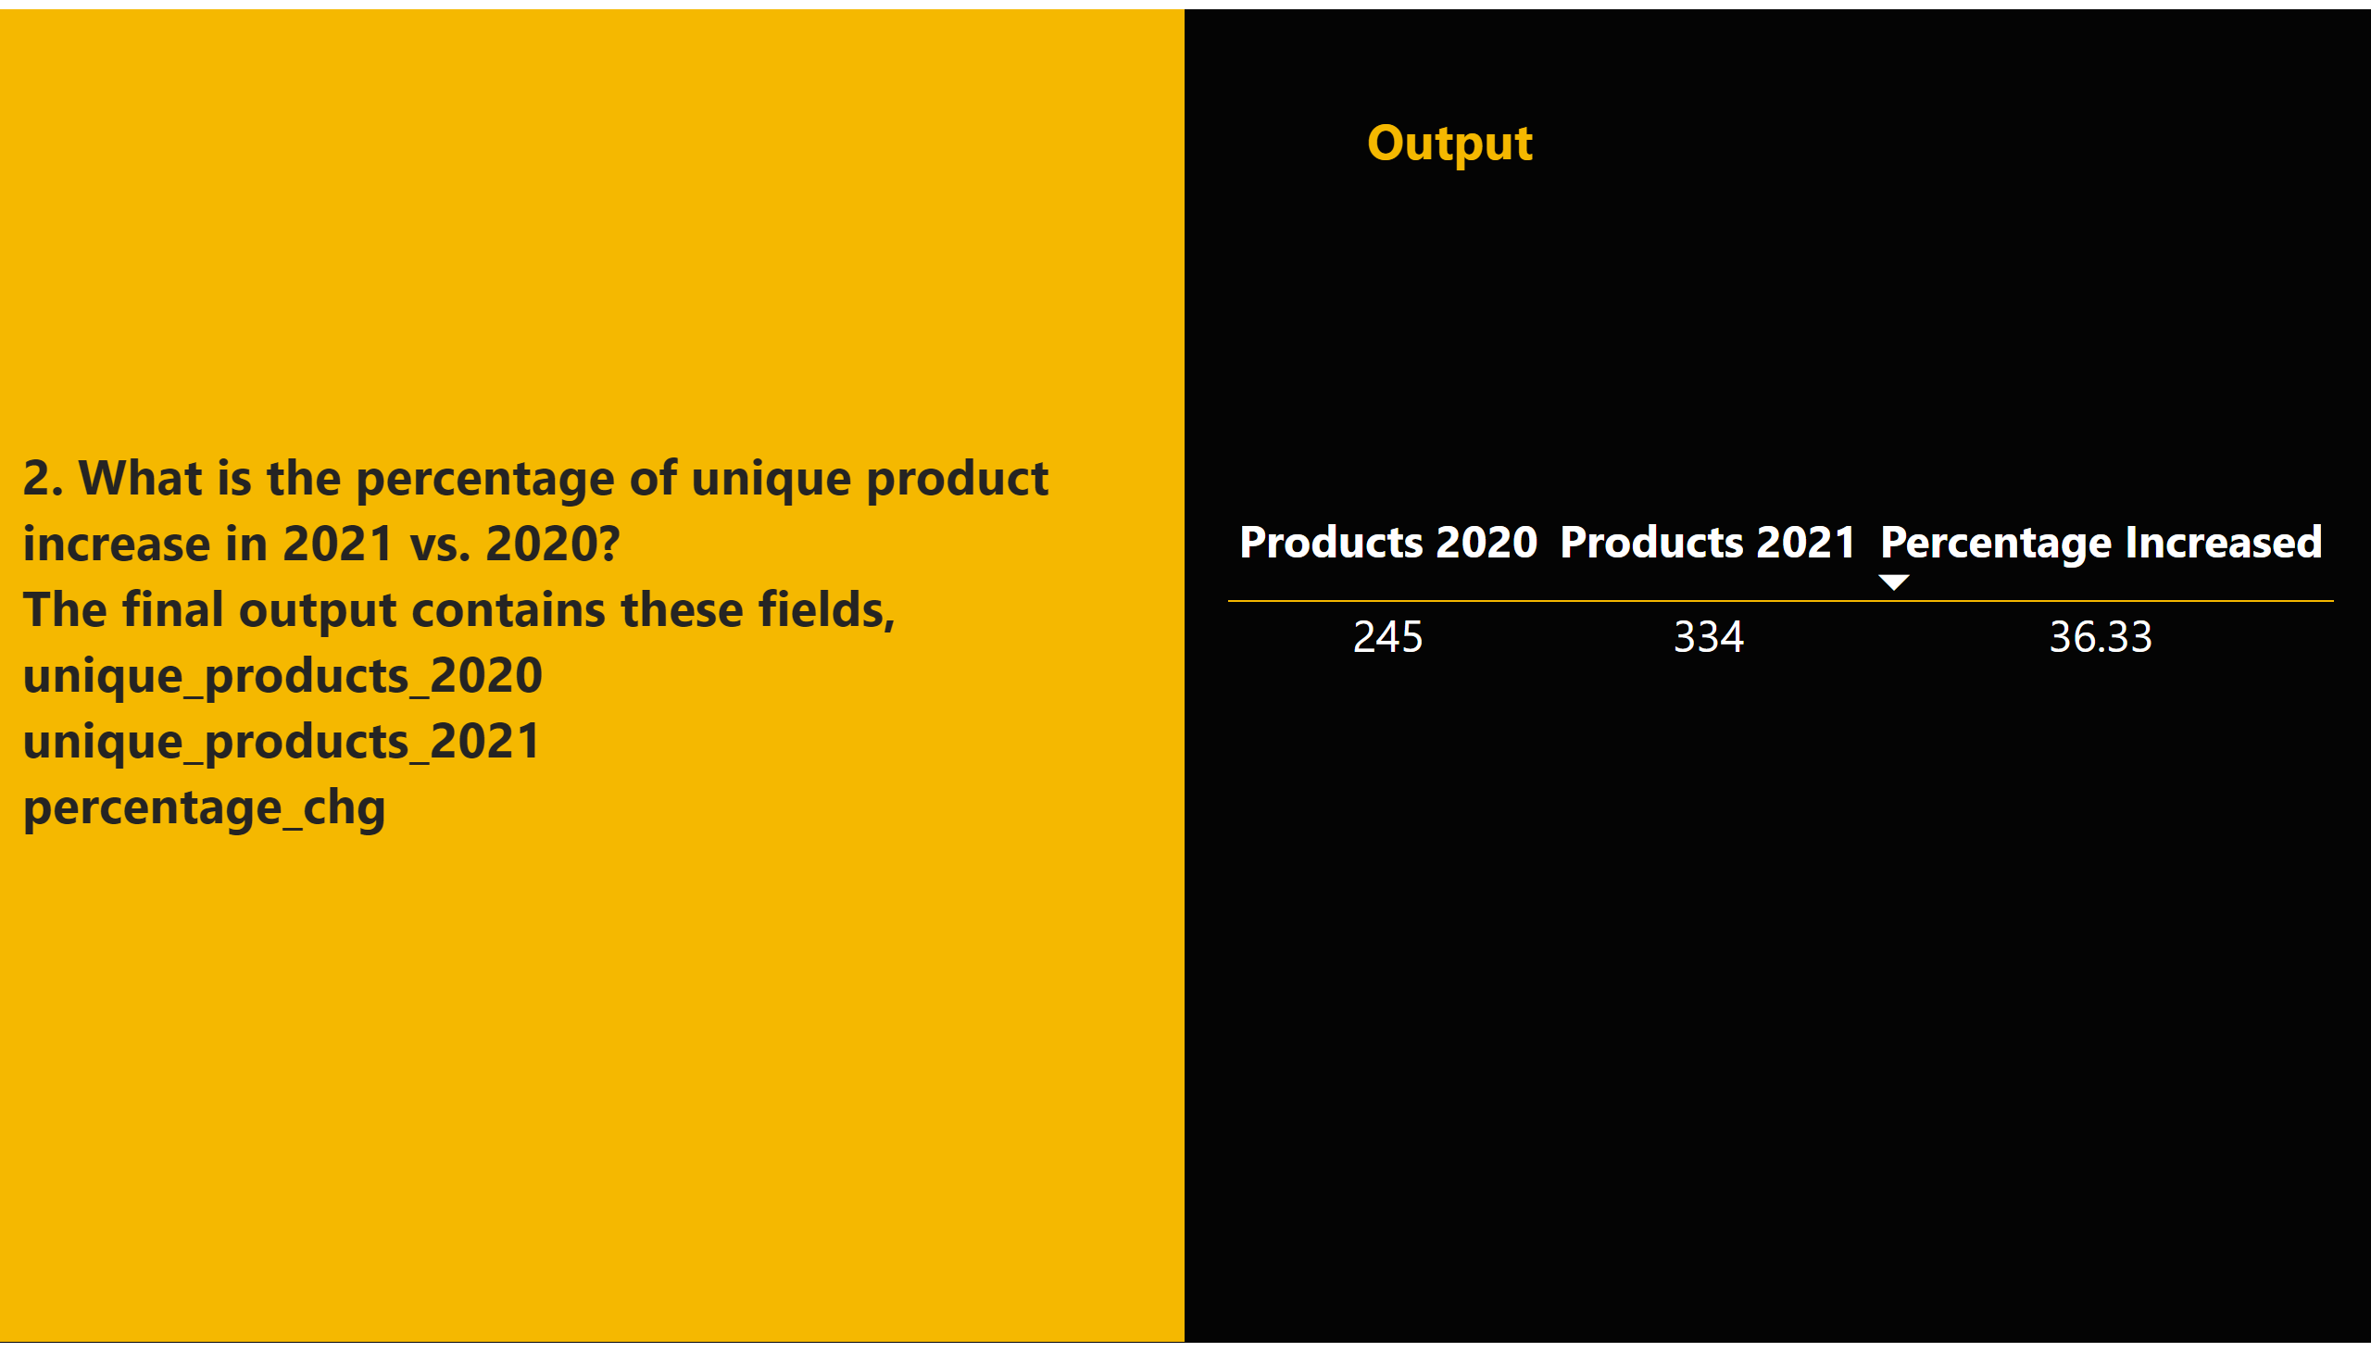
A2
Notes:
shape
No alt text provided
tableEx
No alt text provided
textbox
No alt text provided
textbox
No alt text provided
shape
No alt text provided

Slide 15
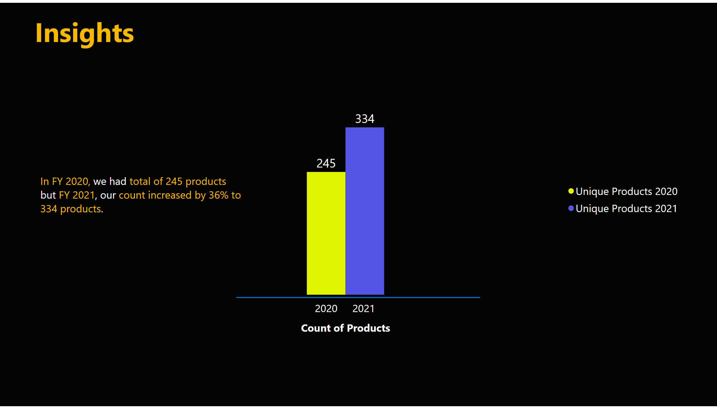
request2
Notes:
clusteredColumnChart
No alt text provided
textbox
No alt text provided
shape
No alt text provided
textbox
No alt text provided
textbox
No alt text provided
textbox
No alt text provided
textbox
No alt text provided

Slide 16
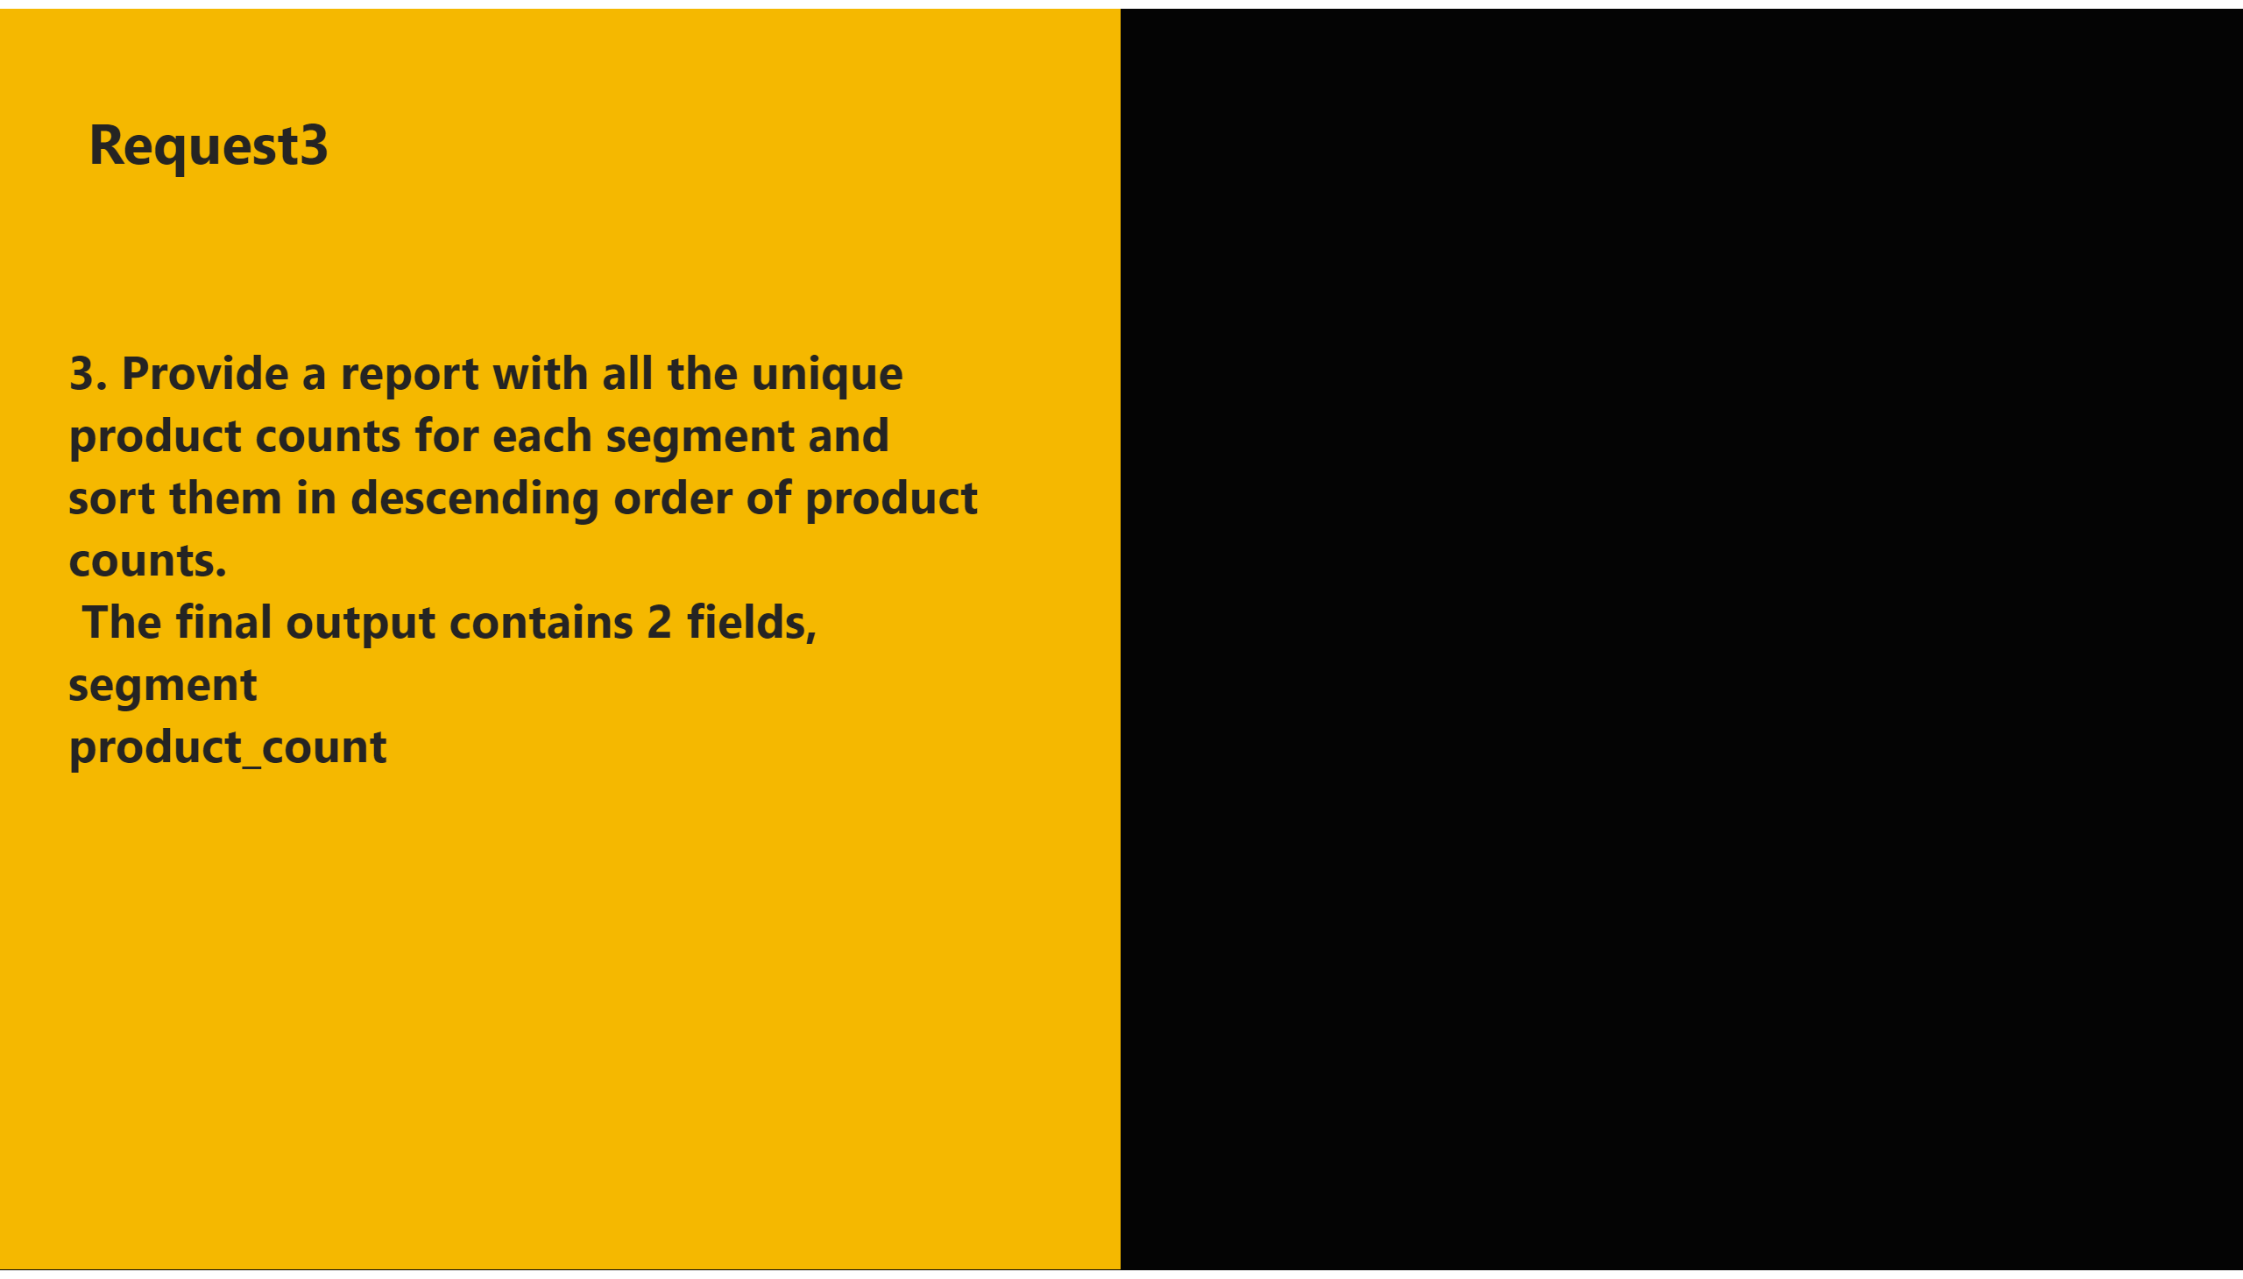
3
Notes:
shape
No alt text provided
textbox
No alt text provided
textbox
No alt text provided
shape
No alt text provided

Slide 17
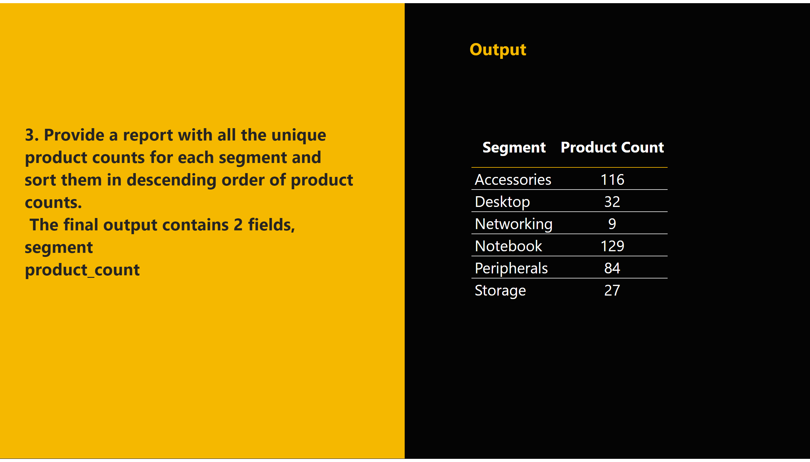
A3
Notes:
shape
No alt text provided
tableEx
No alt text provided
textbox
No alt text provided
textbox
No alt text provided
shape
No alt text provided

Slide 18
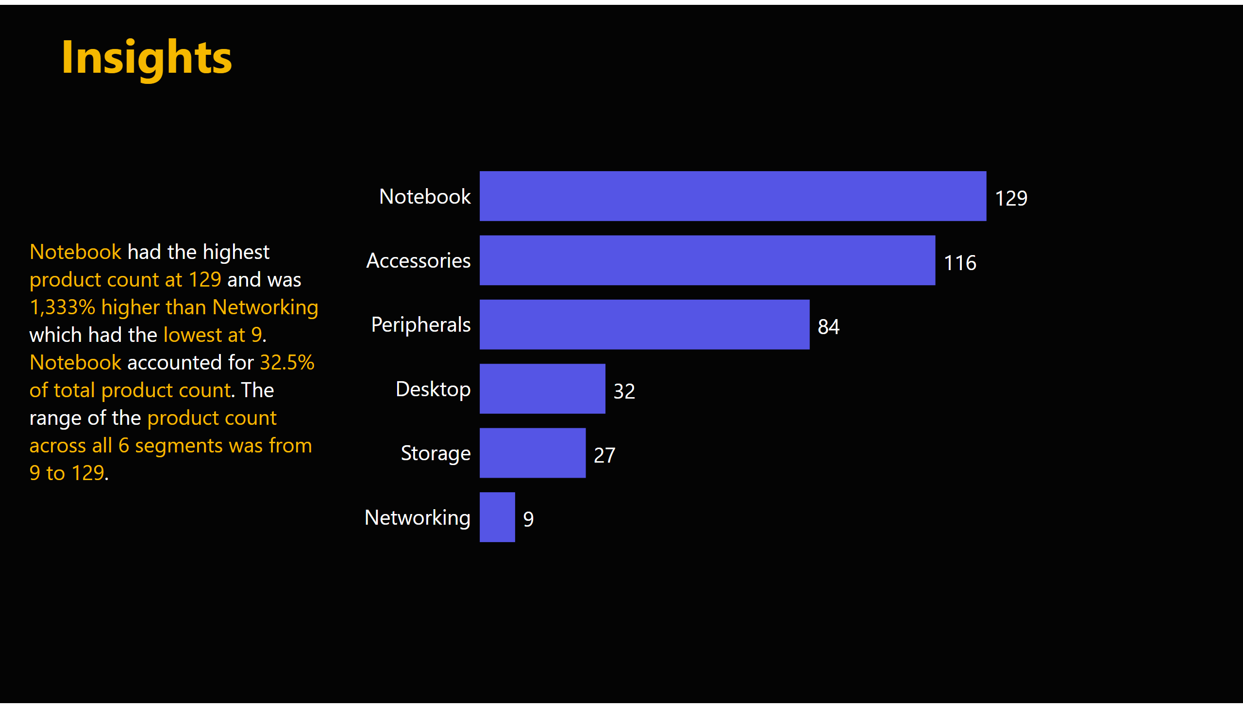
request3
Notes:
clusteredBarChart
No alt text provided
textbox
No alt text provided
textbox
No alt text provided

Slide 19
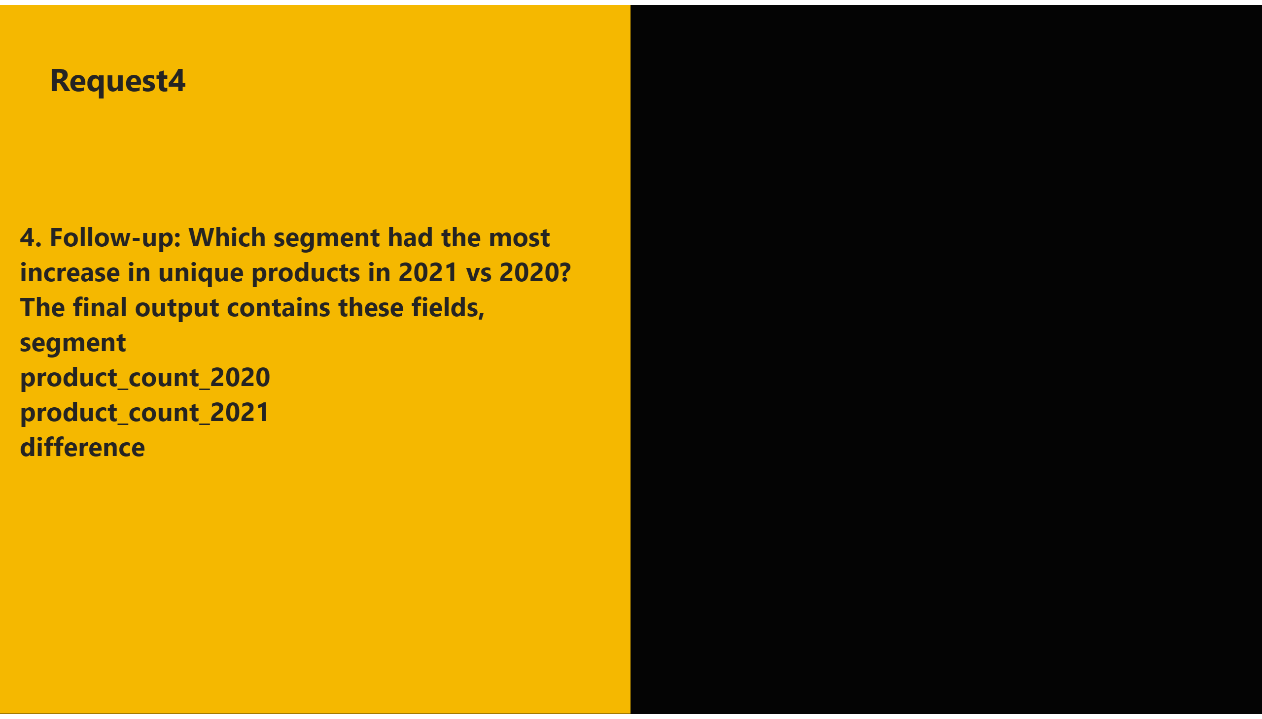
4
Notes:
shape
No alt text provided
textbox
No alt text provided
textbox
No alt text provided
shape
No alt text provided

Slide 20
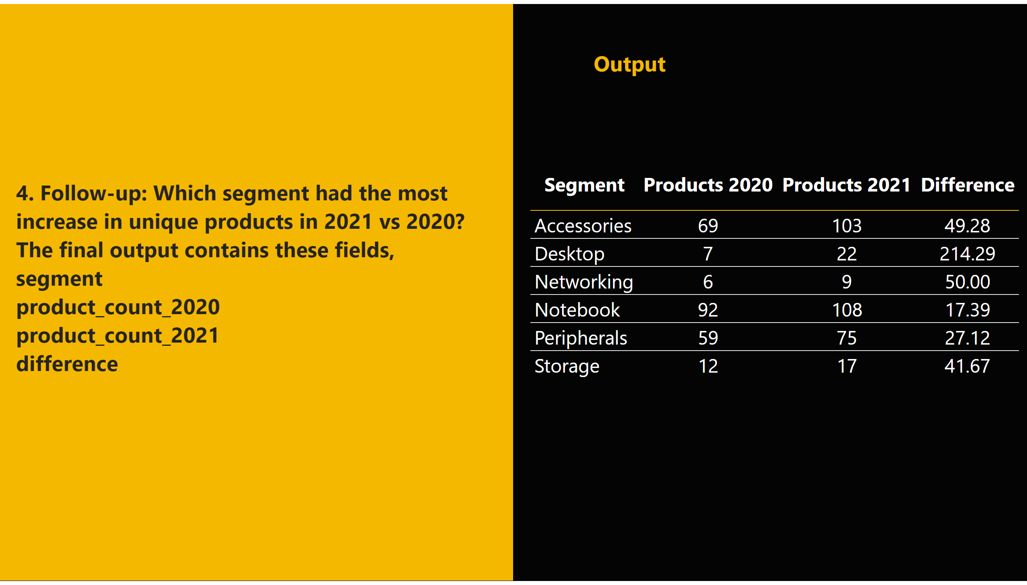
A4
Notes:
shape
No alt text provided
tableEx
No alt text provided
textbox
No alt text provided
textbox
No alt text provided
shape
No alt text provided

Slide 21
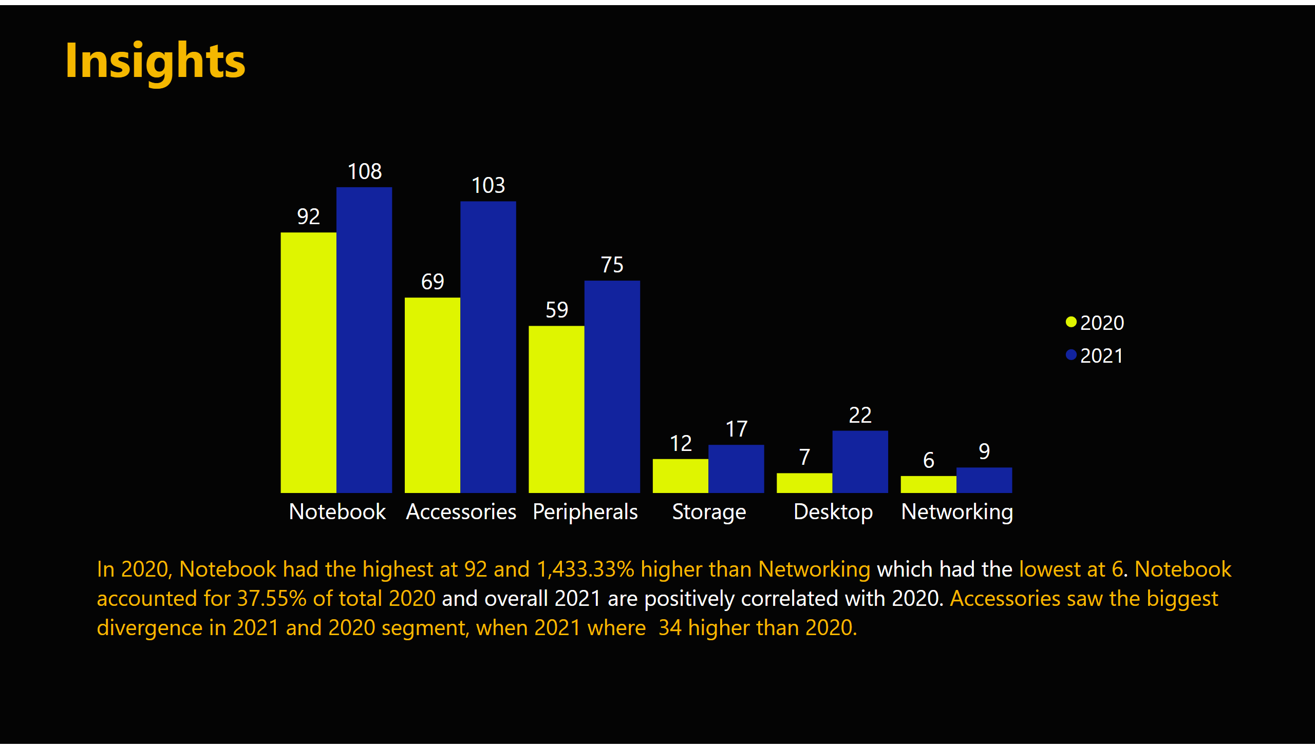
request4
Notes:
clusteredColumnChart
No alt text provided
textbox
No alt text provided
textbox
No alt text provided

Slide 22
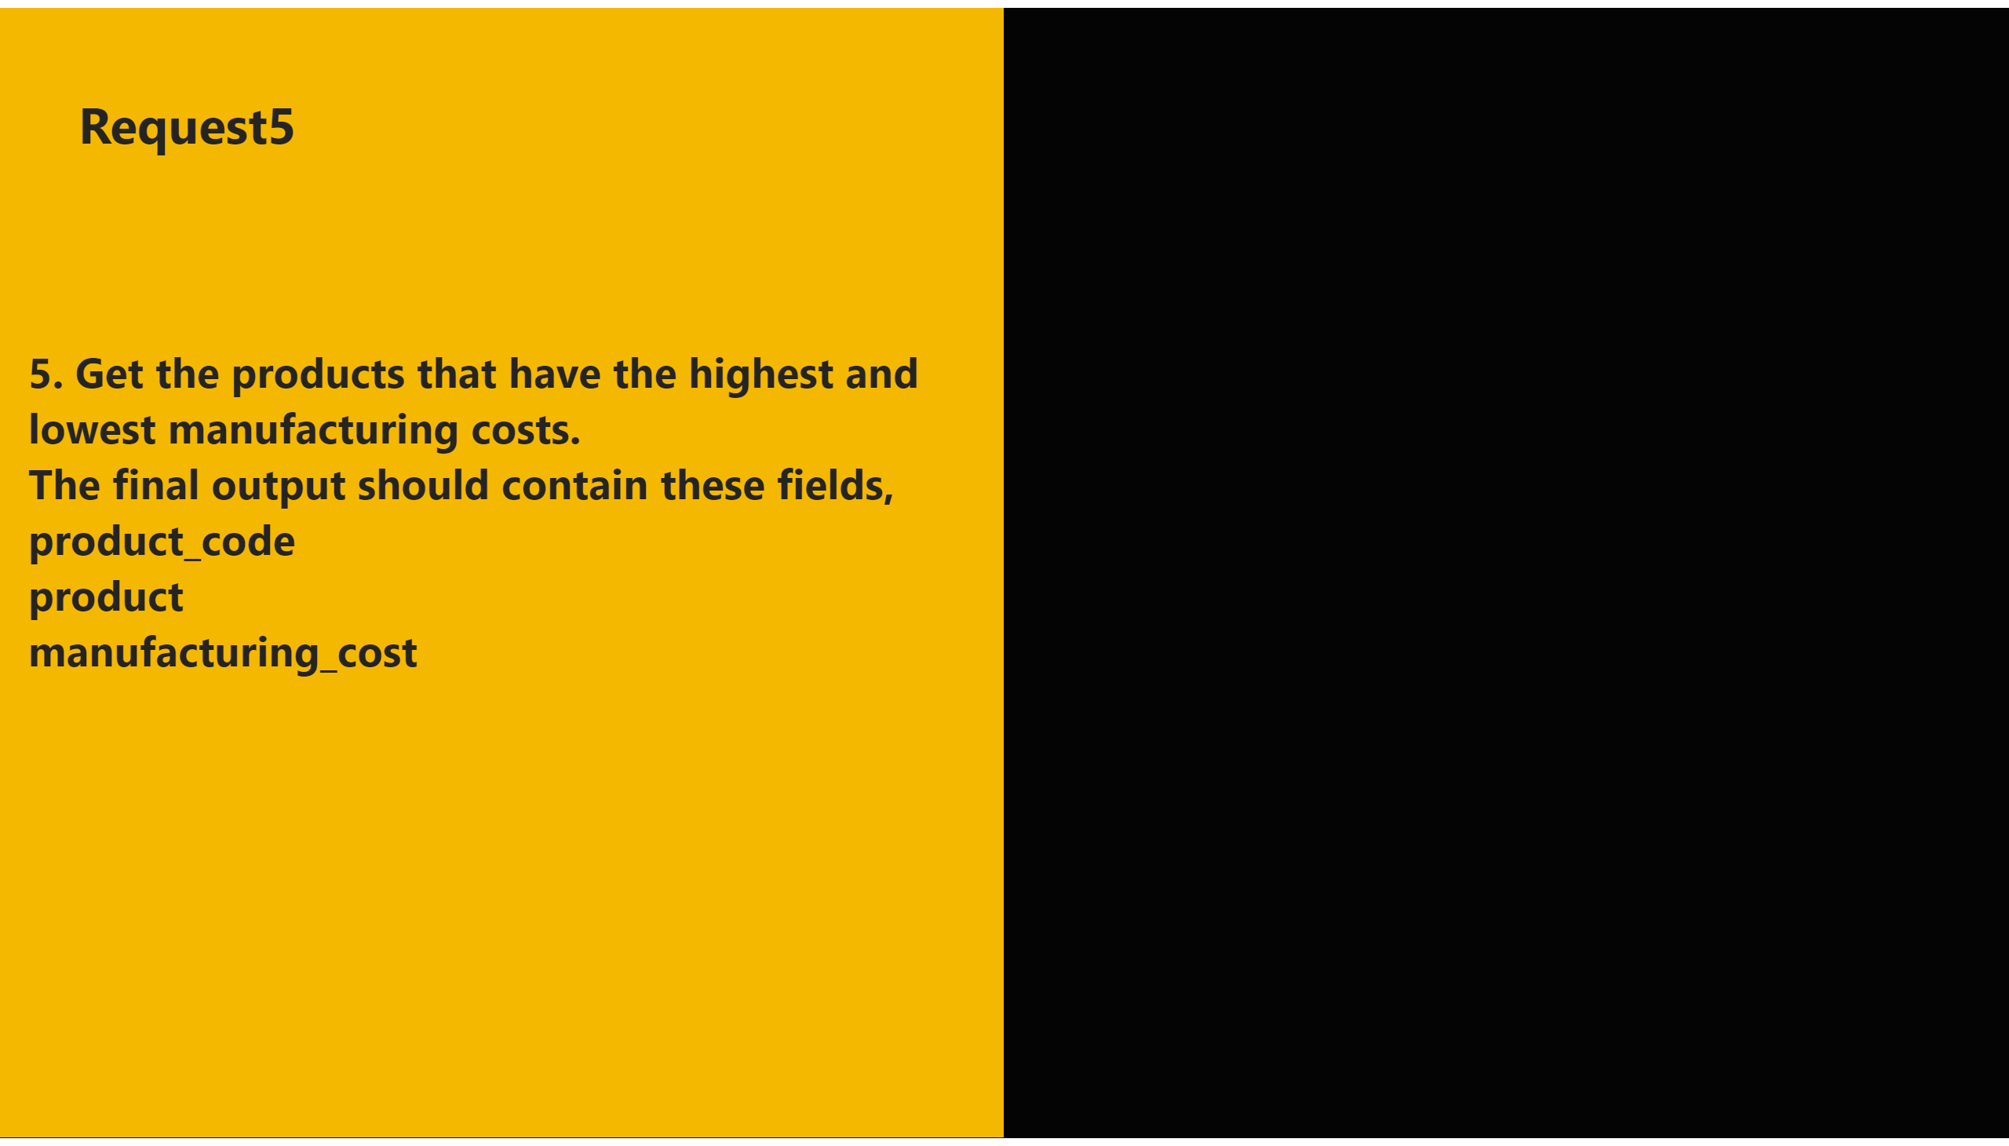
5
Notes:
shape
No alt text provided
textbox
No alt text provided
textbox
No alt text provided
shape
No alt text provided

Slide 23
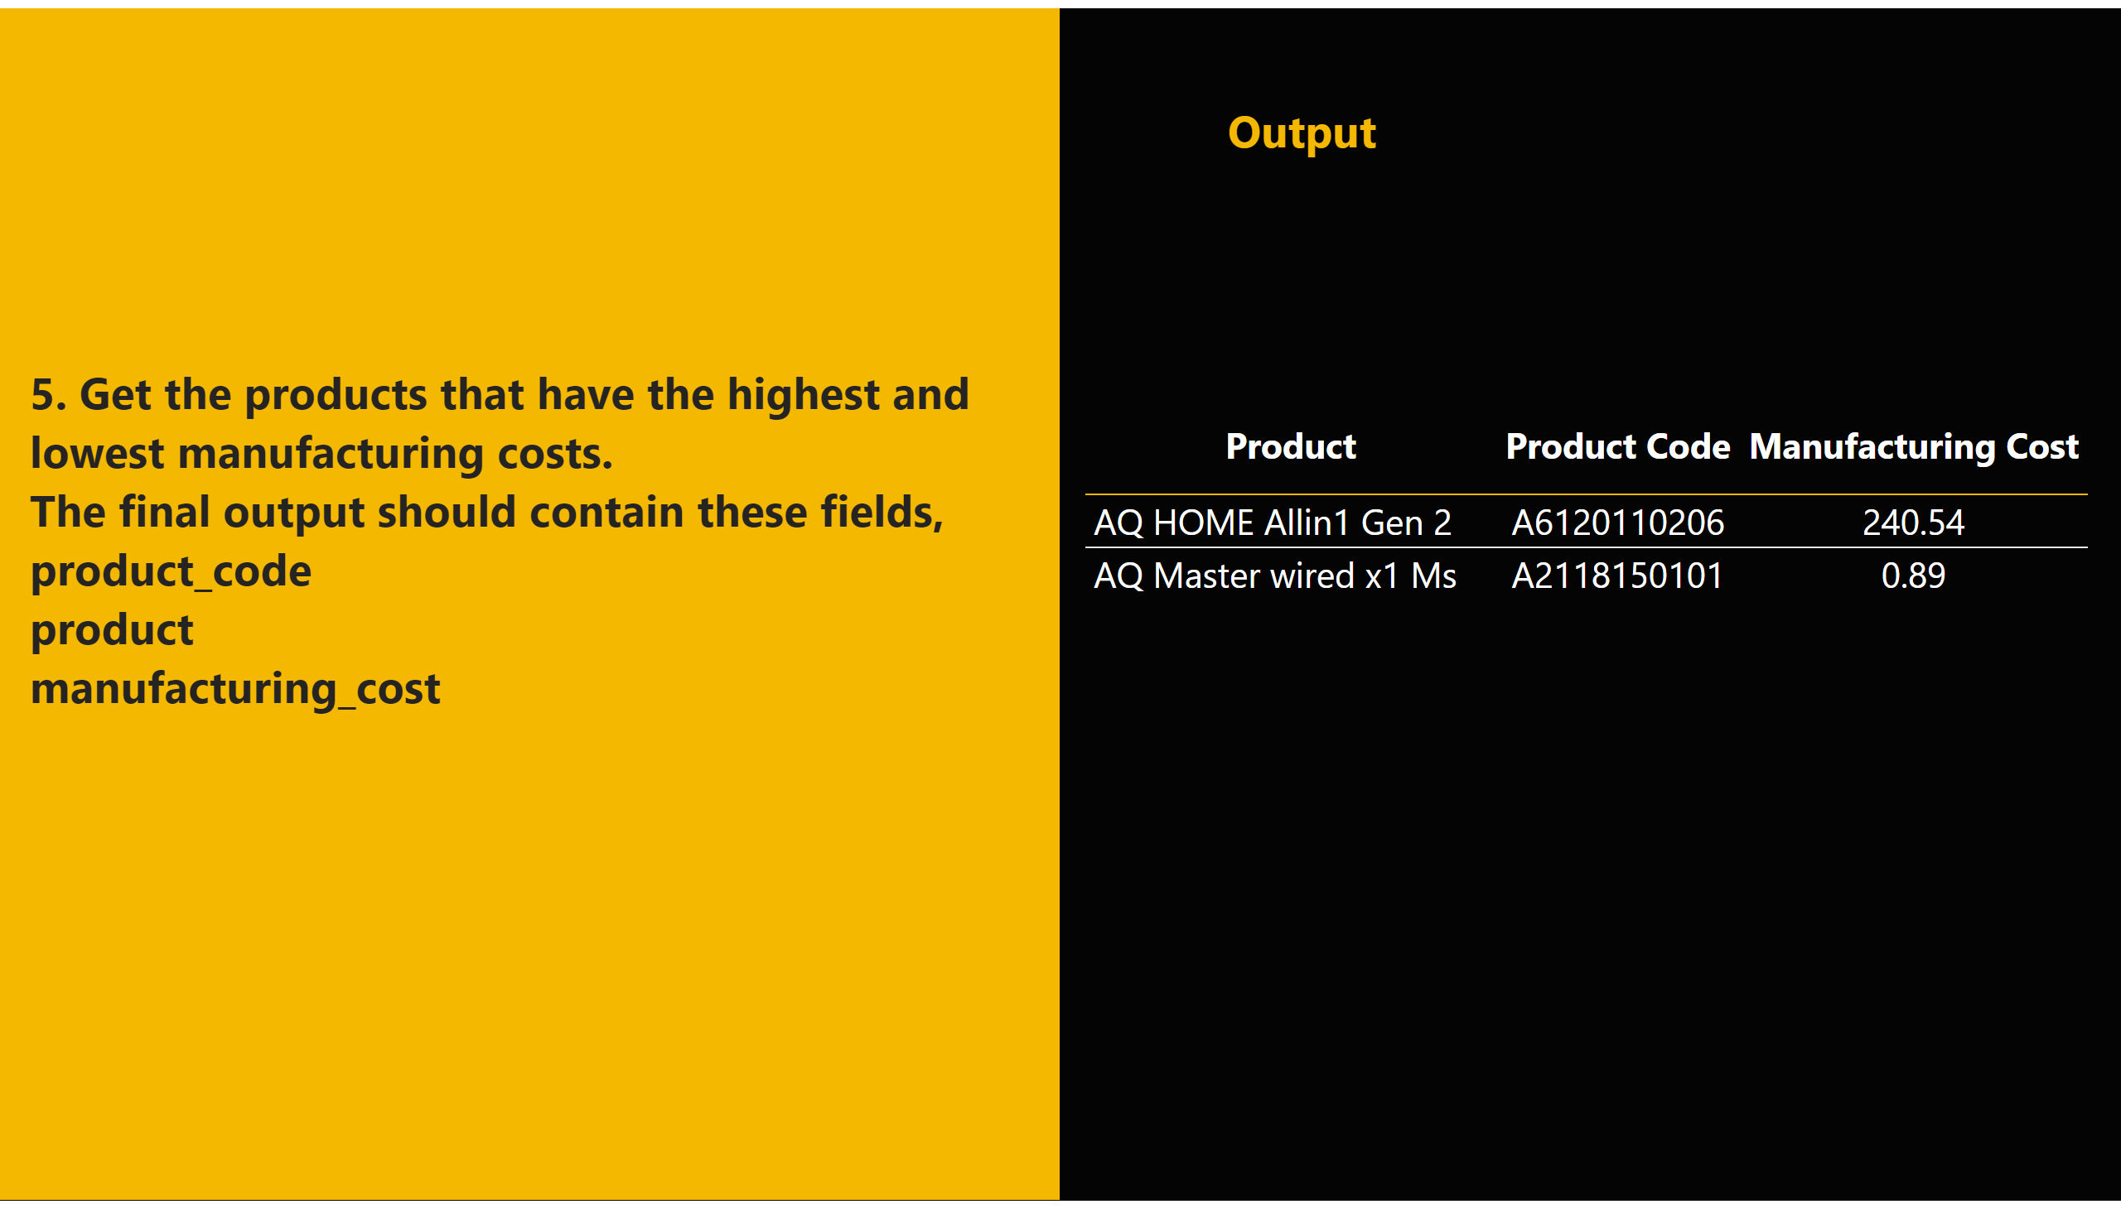
A5
Notes:
shape
No alt text provided
tableEx
No alt text provided
textbox
No alt text provided
textbox
No alt text provided
shape
No alt text provided

Slide 24
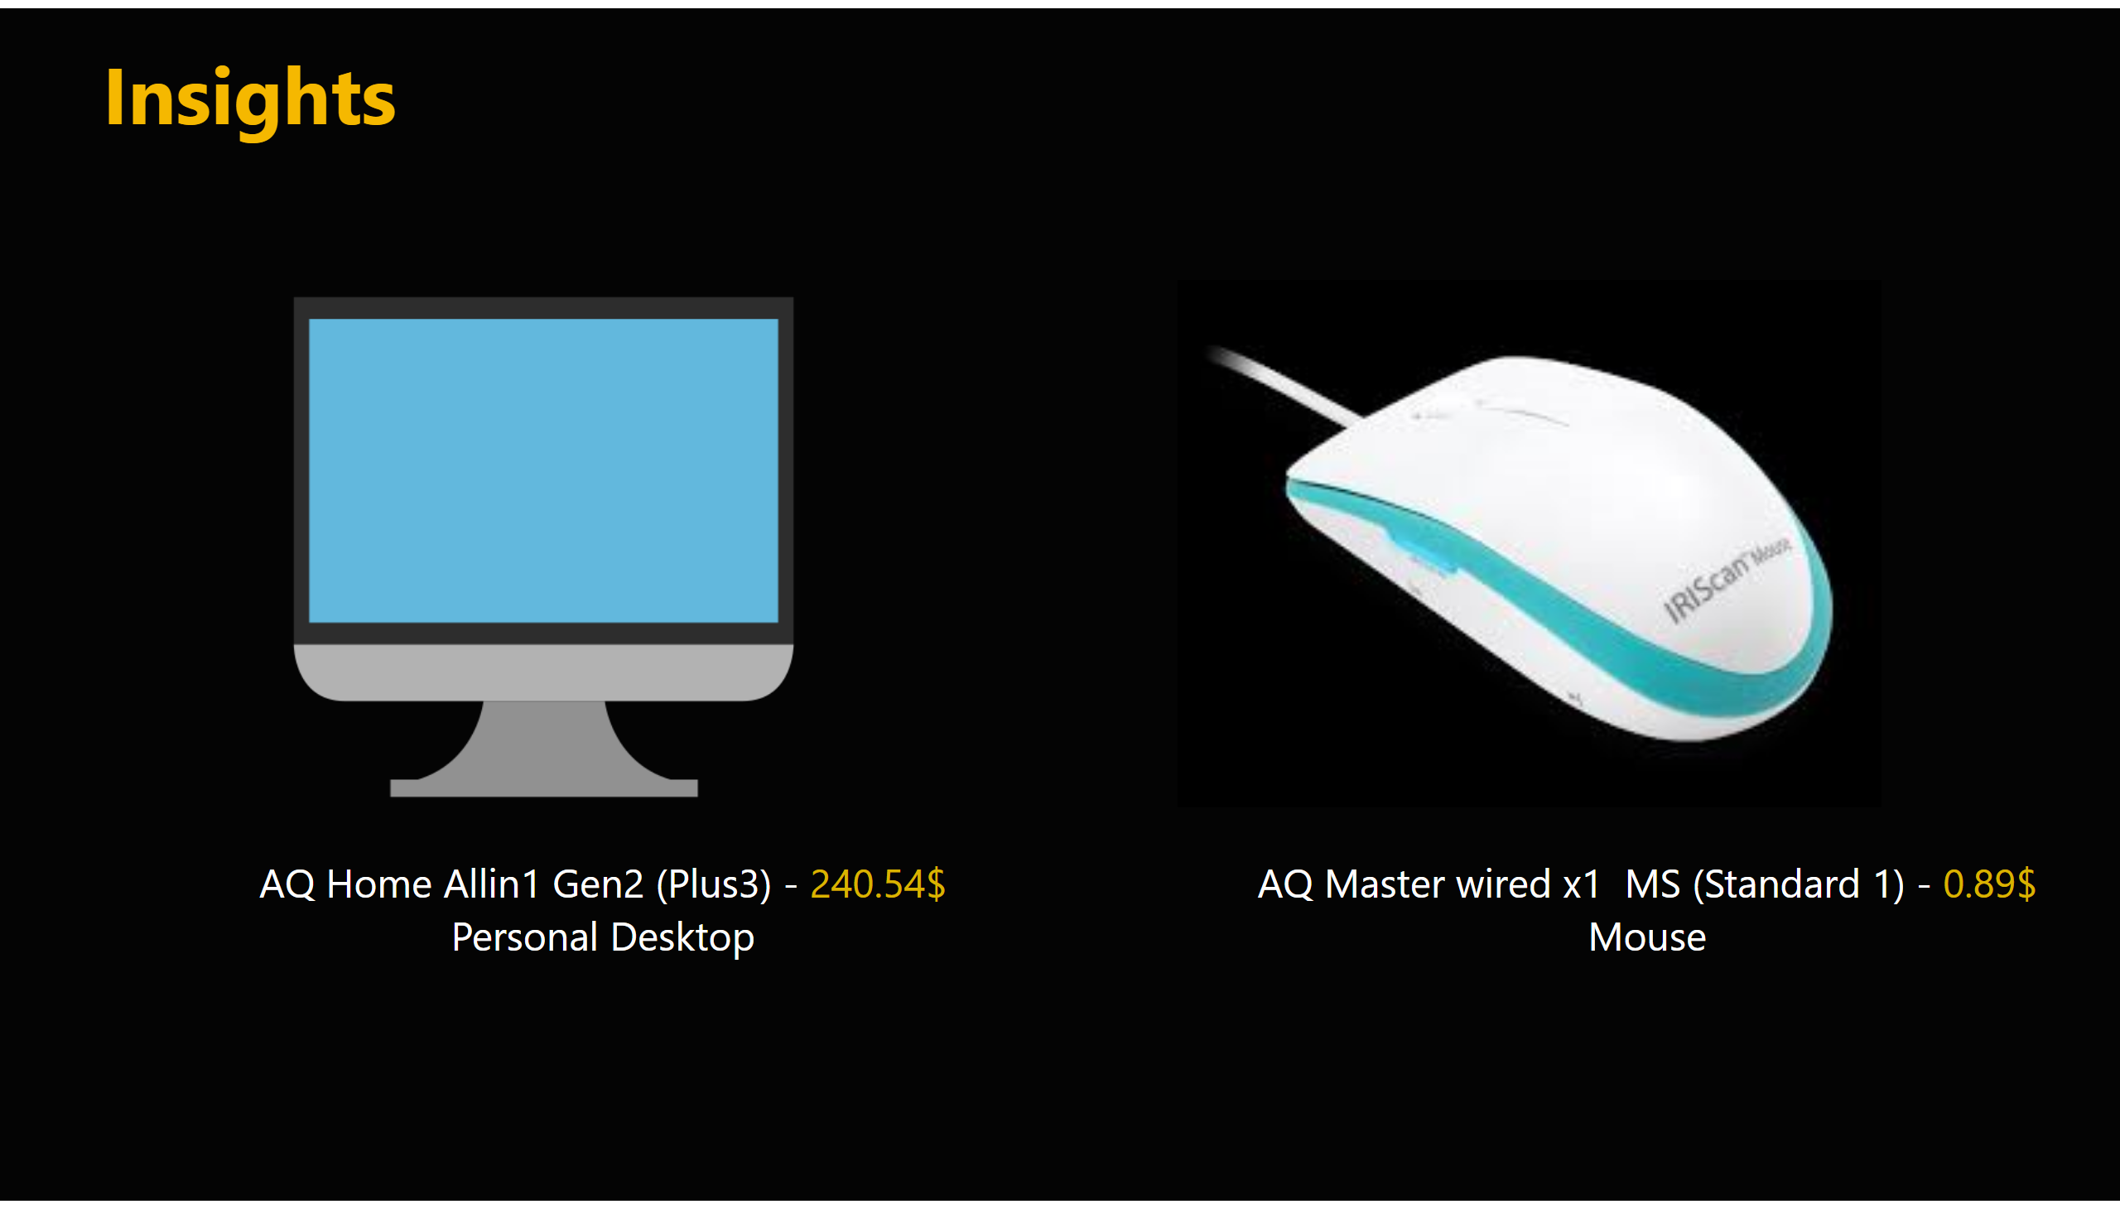
request5
Notes:
textbox
No alt text provided
textbox
No alt text provided
image
No alt text provided
image
No alt text provided
textbox
No alt text provided
textbox
No alt text provided

Slide 25
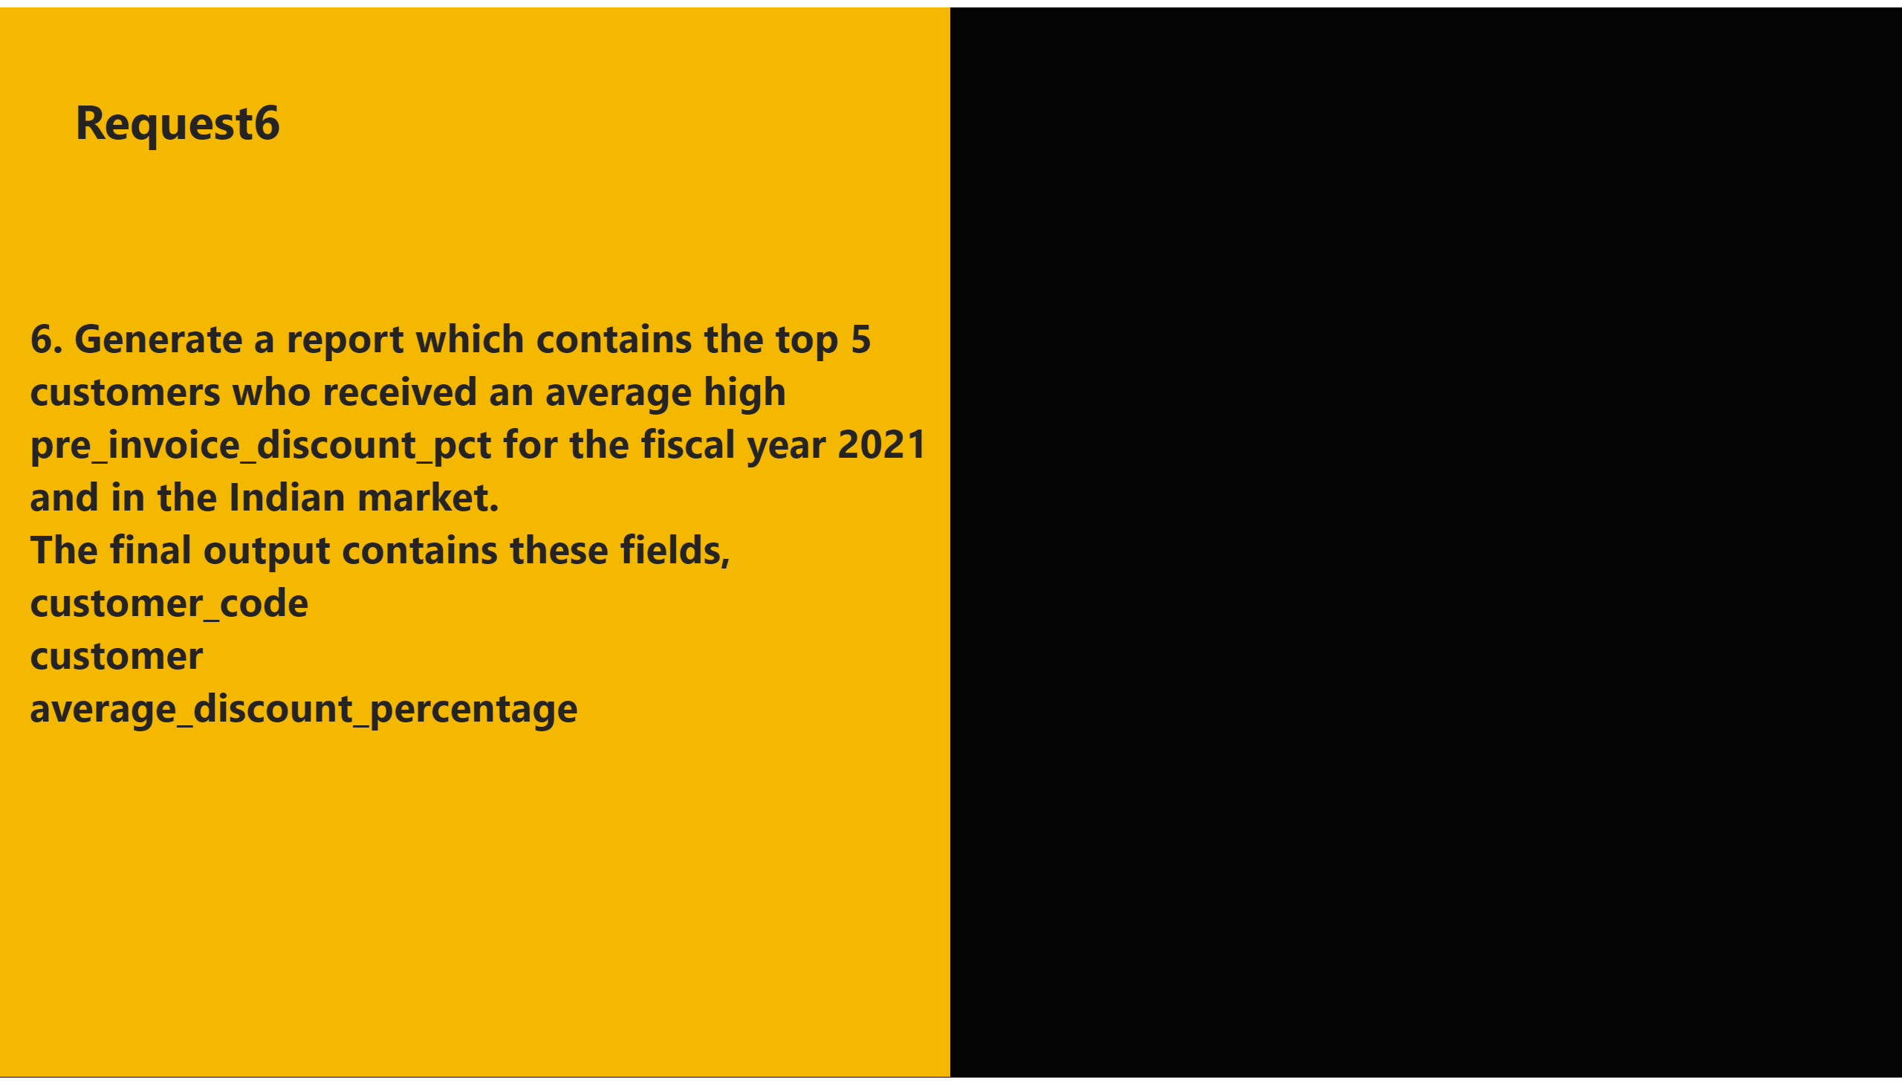
6
Notes:
shape
No alt text provided
textbox
No alt text provided
textbox
No alt text provided
shape
No alt text provided

Slide 26
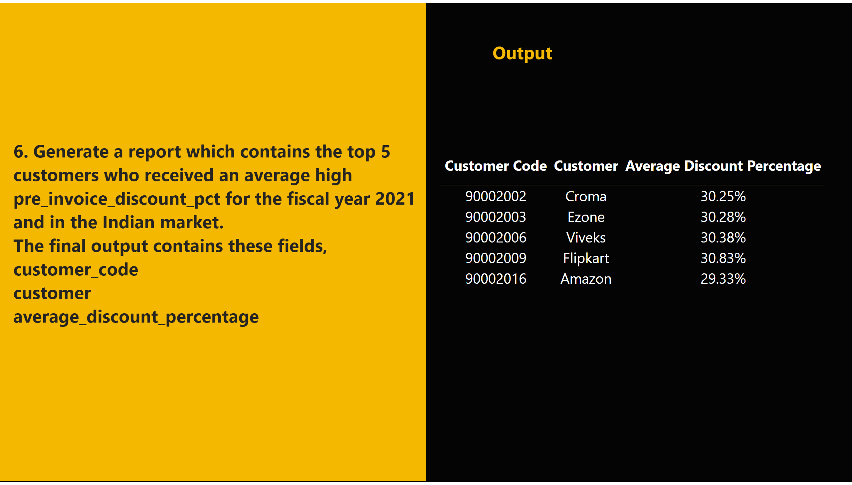
A6
Notes:
shape
No alt text provided
tableEx
No alt text provided
textbox
No alt text provided
textbox
No alt text provided
shape
No alt text provided

Slide 27
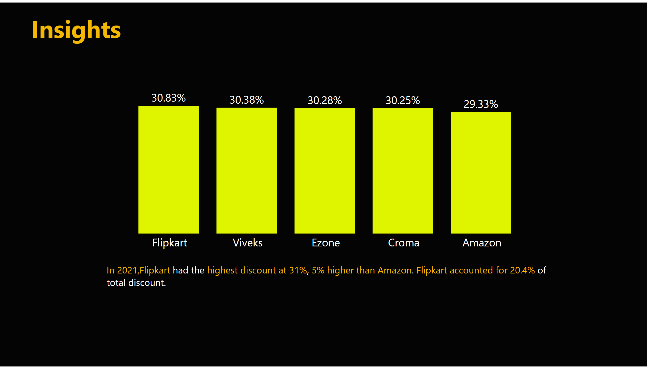
request6
Notes:
clusteredColumnChart
No alt text provided
textbox
No alt text provided
textbox
No alt text provided

Slide 28

7
Notes:
shape
No alt text provided
textbox
No alt text provided
textbox
No alt text provided
shape
No alt text provided

Slide 29
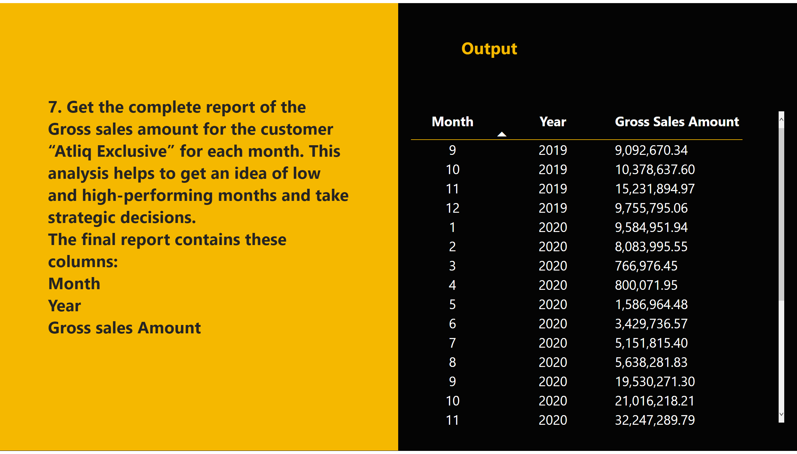
A7
Notes:
shape
No alt text provided
tableEx
No alt text provided
textbox
No alt text provided
textbox
No alt text provided
shape
No alt text provided

Slide 30
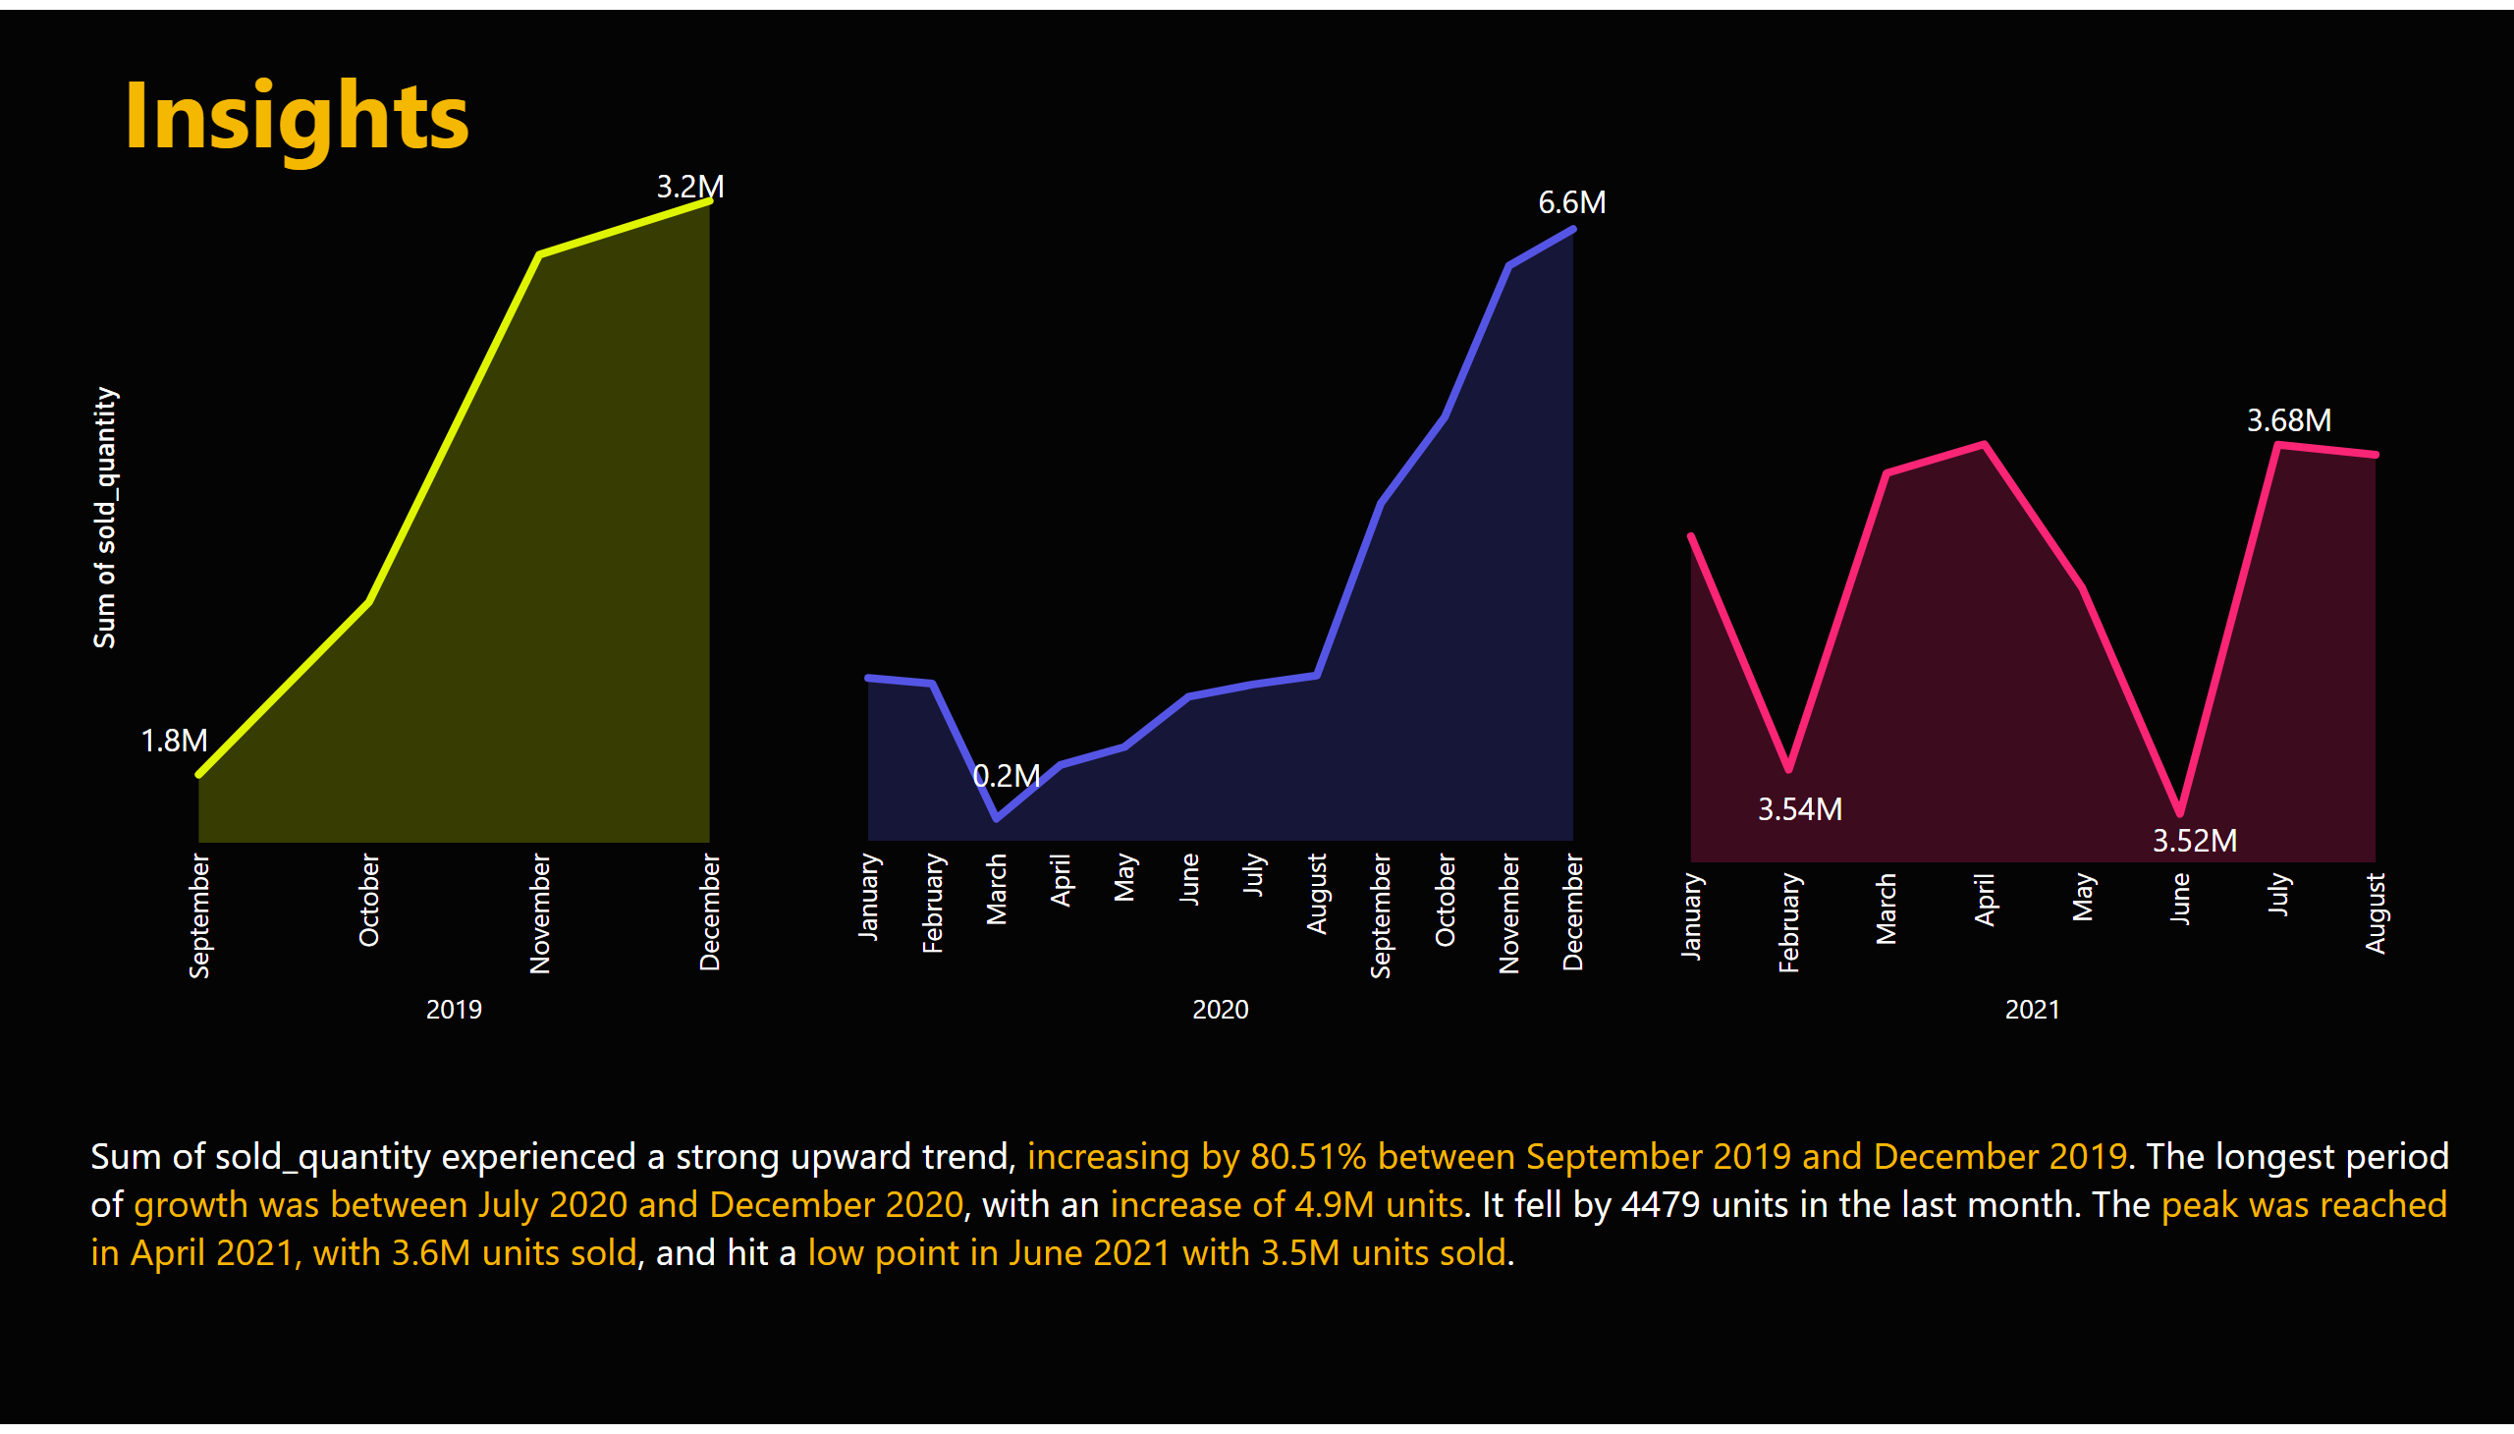
request7
Notes:
areaChart
No alt text provided
areaChart
No alt text provided
areaChart
No alt text provided
textbox
No alt text provided
textbox
No alt text provided
textbox
No alt text provided
textbox
No alt text provided
textbox
No alt text provided
textbox
No alt text provided
textbox
No alt text provided
textbox
No alt text provided
textbox
No alt text provided

Slide 31
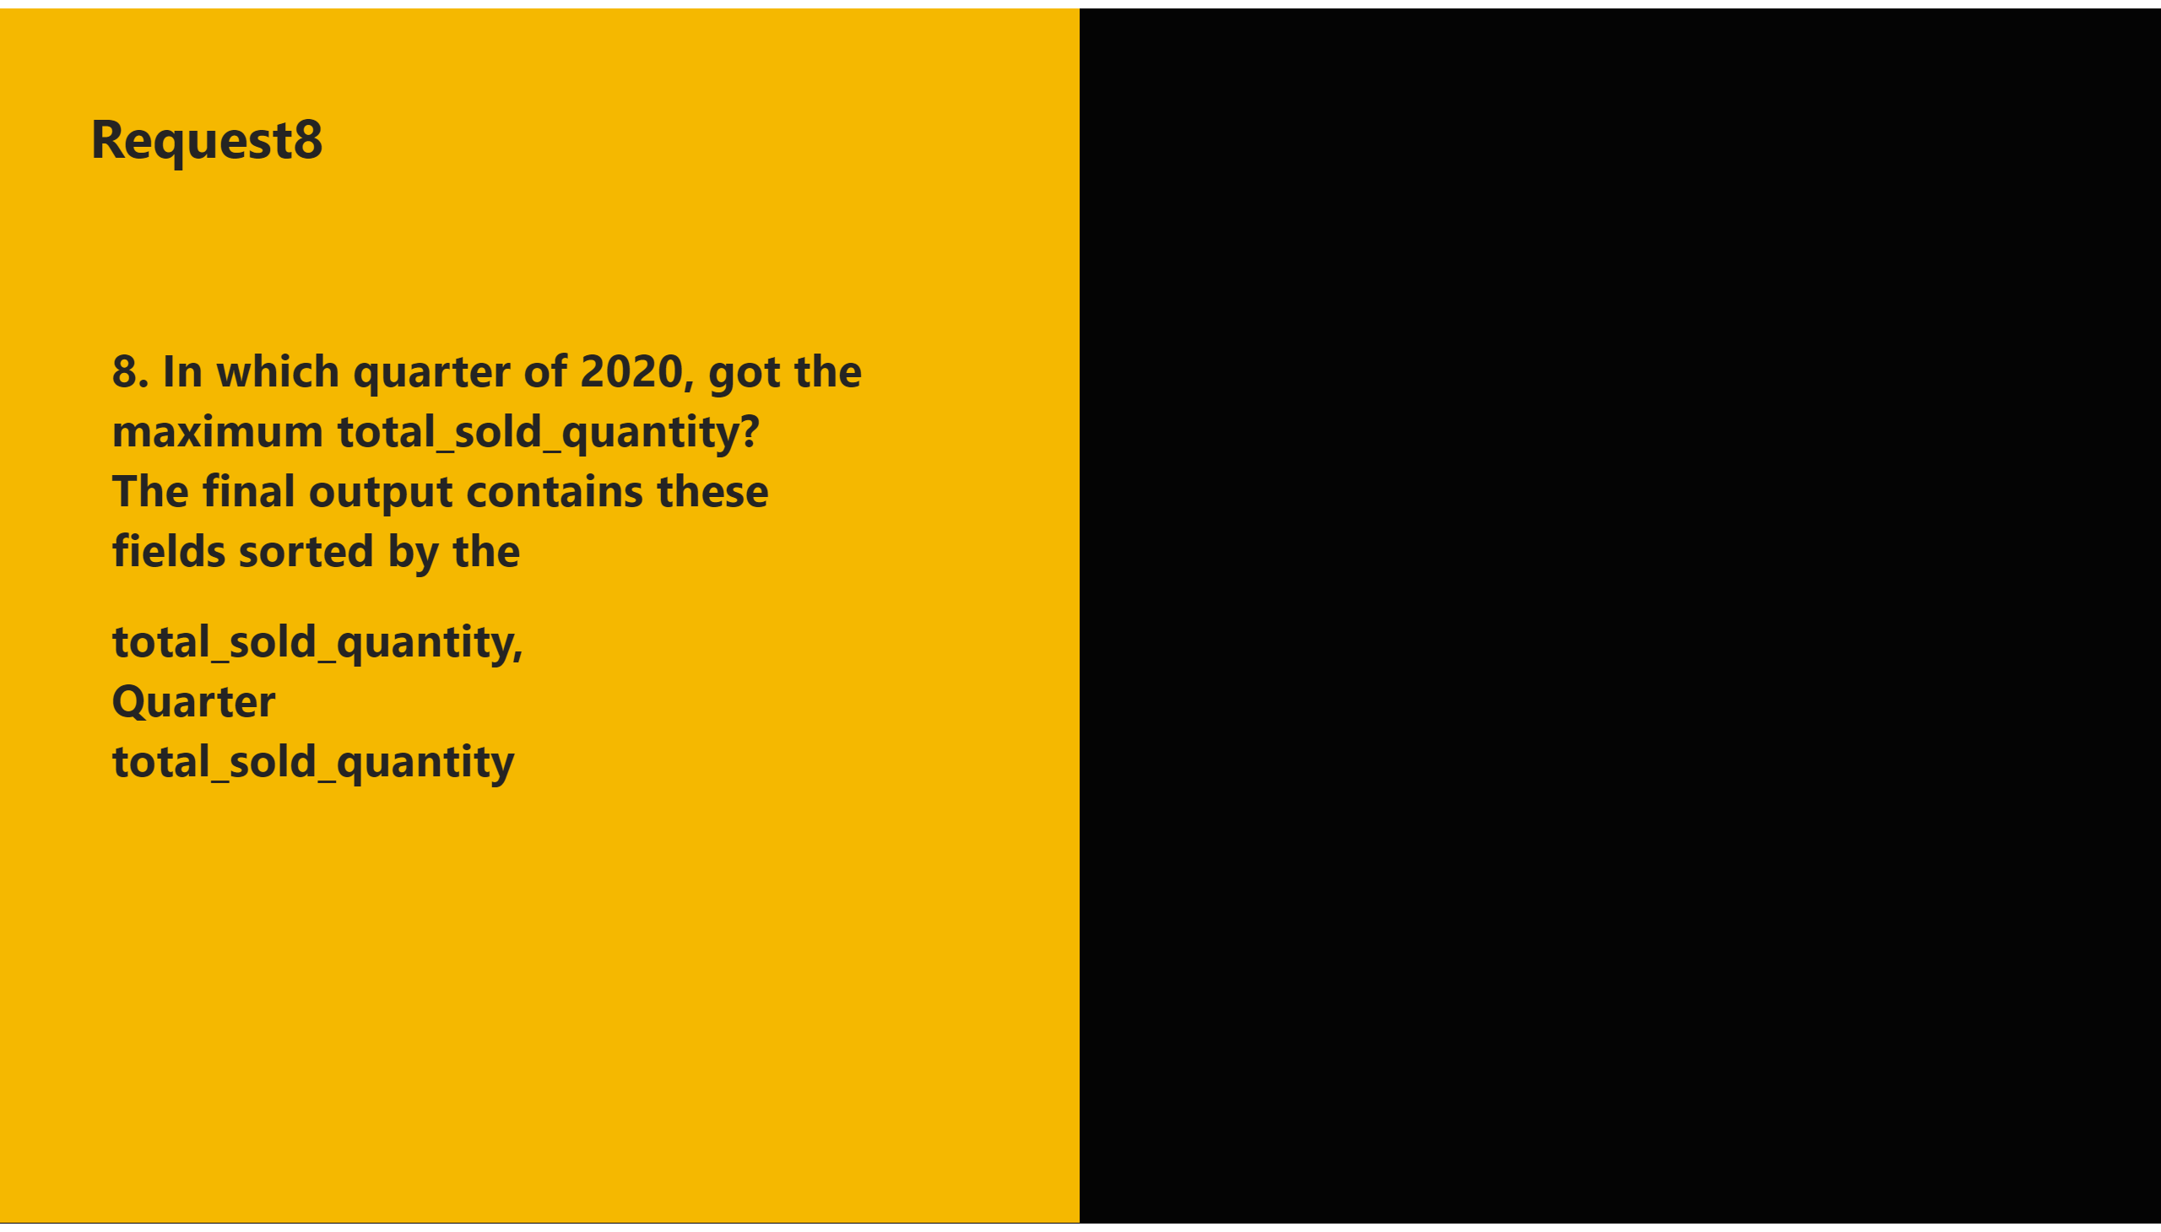
8
Notes:
shape
No alt text provided
textbox
No alt text provided
textbox
No alt text provided
shape
No alt text provided

Slide 32
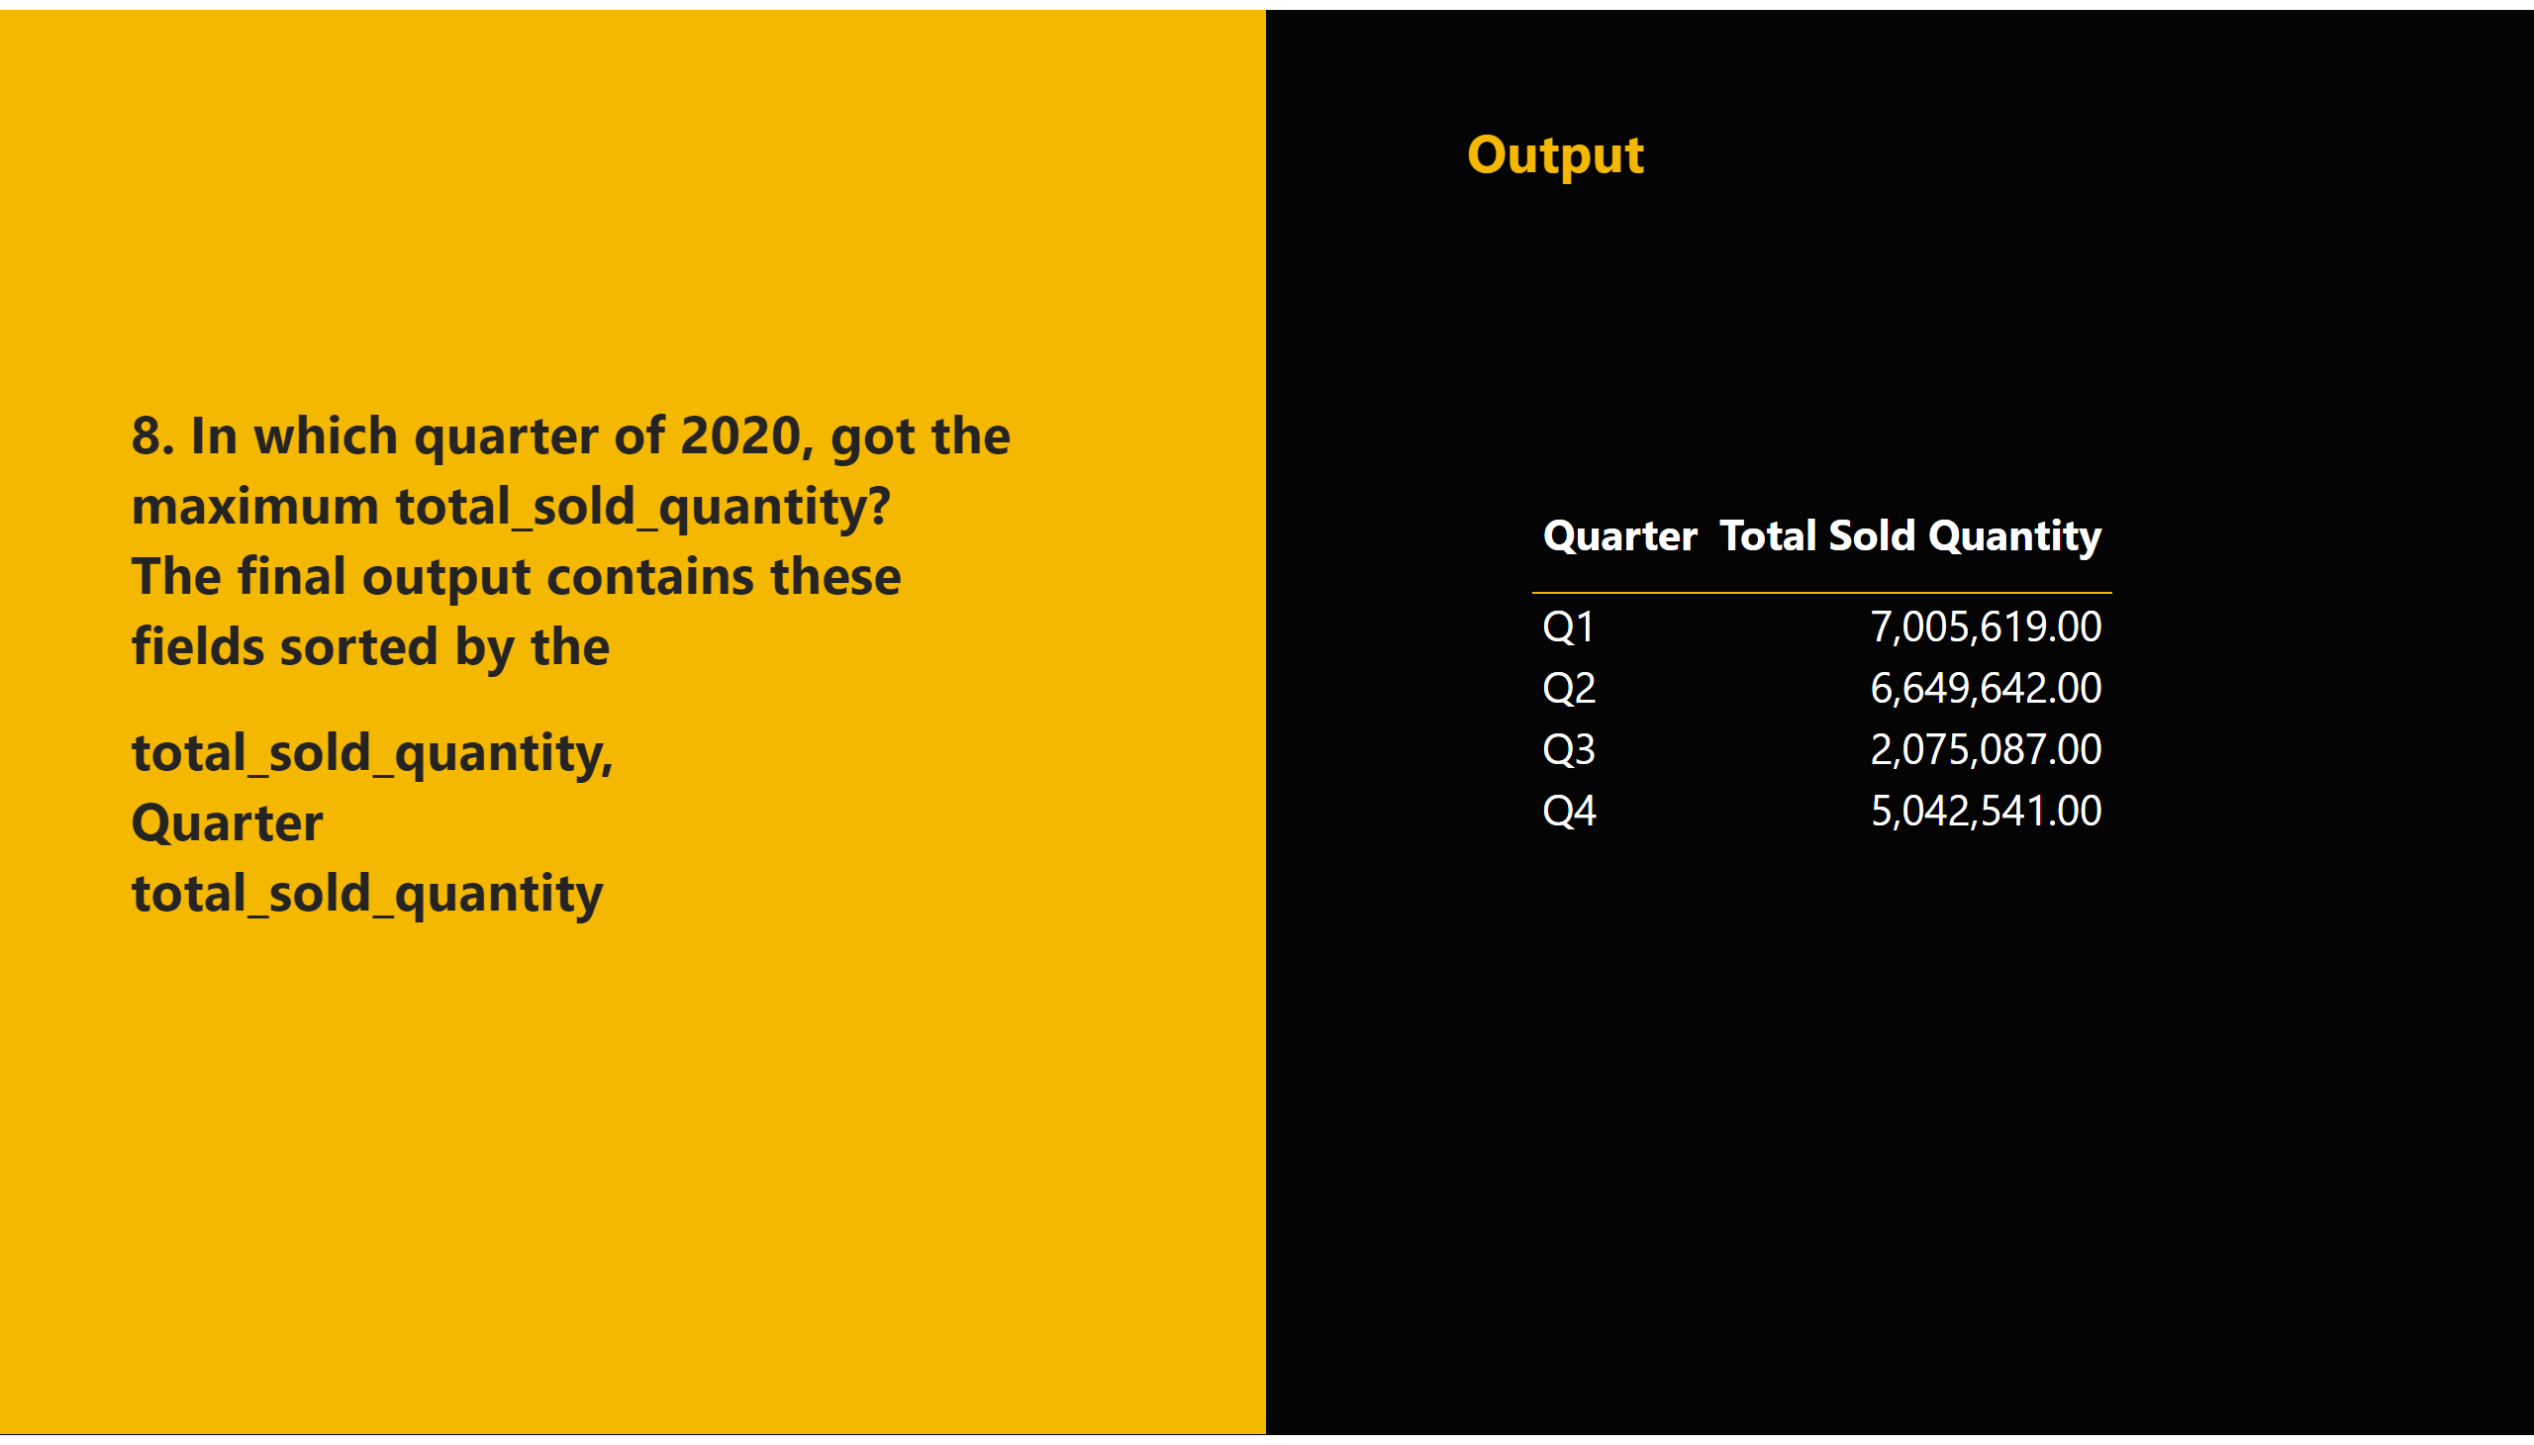
A8
Notes:
shape
No alt text provided
tableEx
No alt text provided
textbox
No alt text provided
textbox
No alt text provided
shape
No alt text provided

Slide 33
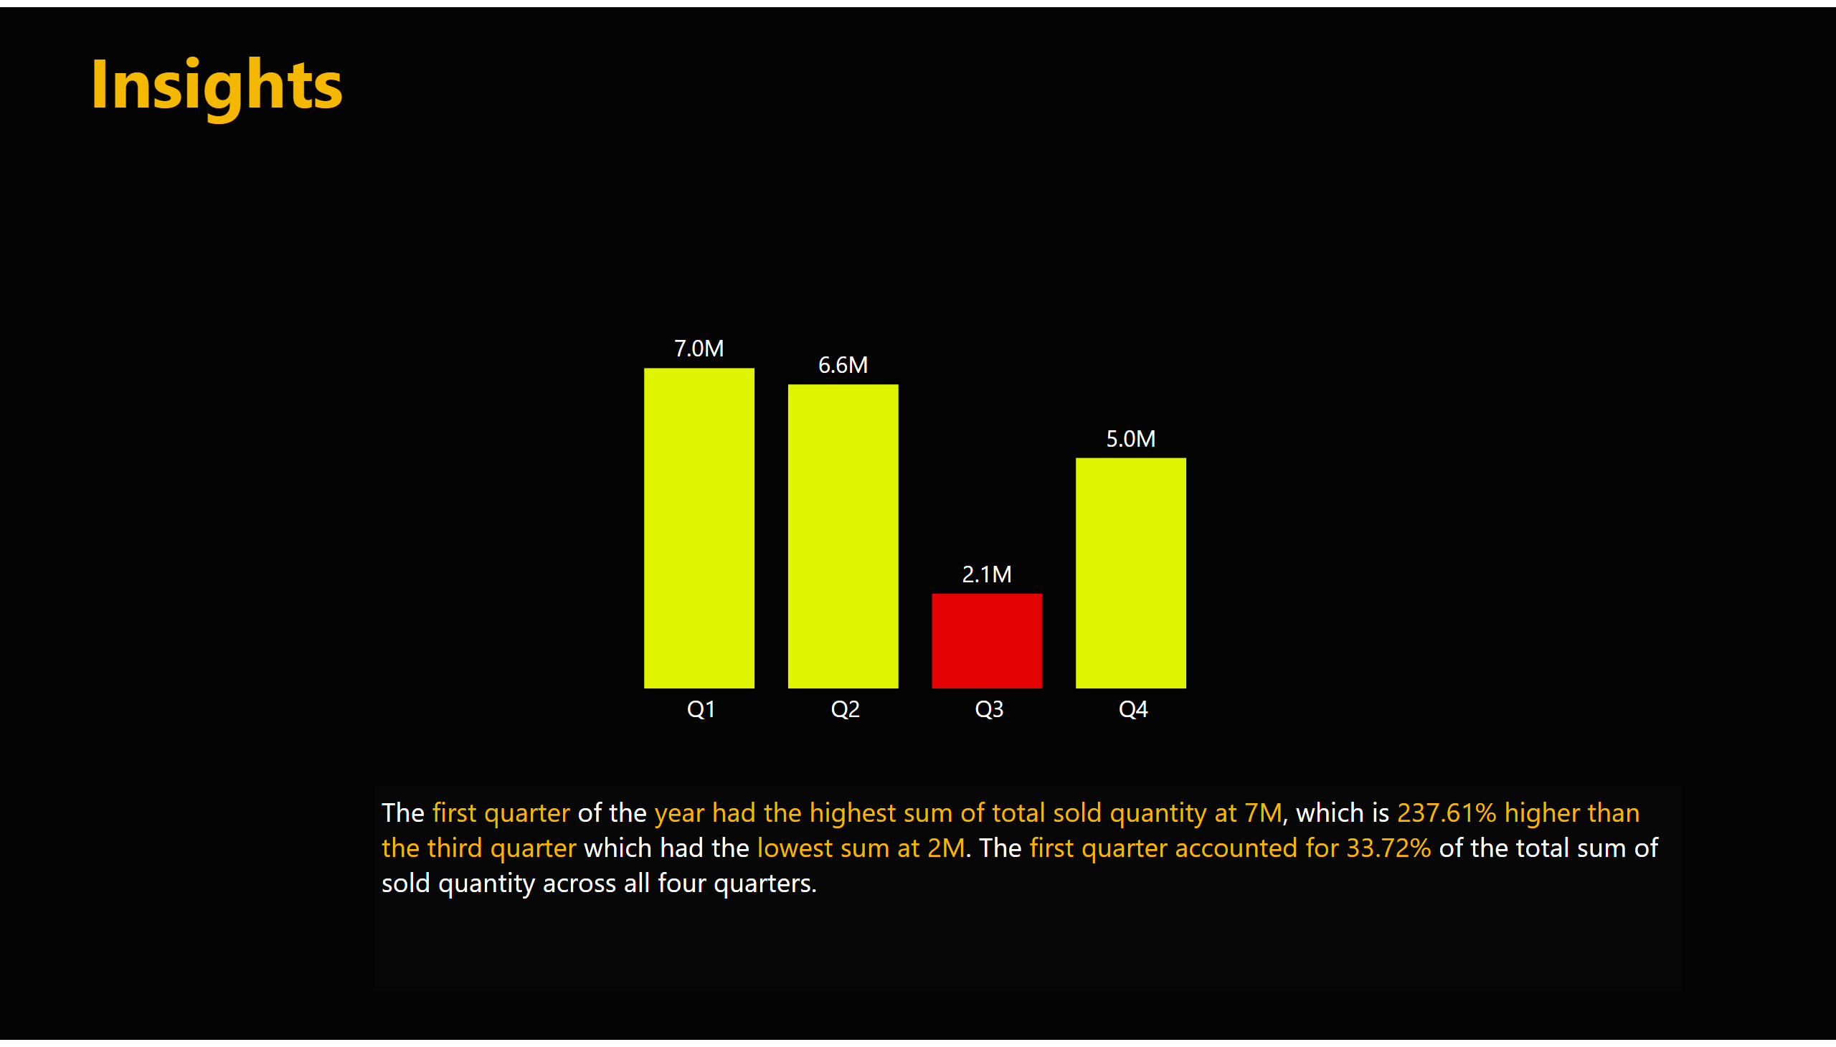
request8
Notes:
clusteredColumnChart
No alt text provided
textbox
No alt text provided
textbox
No alt text provided

Slide 34
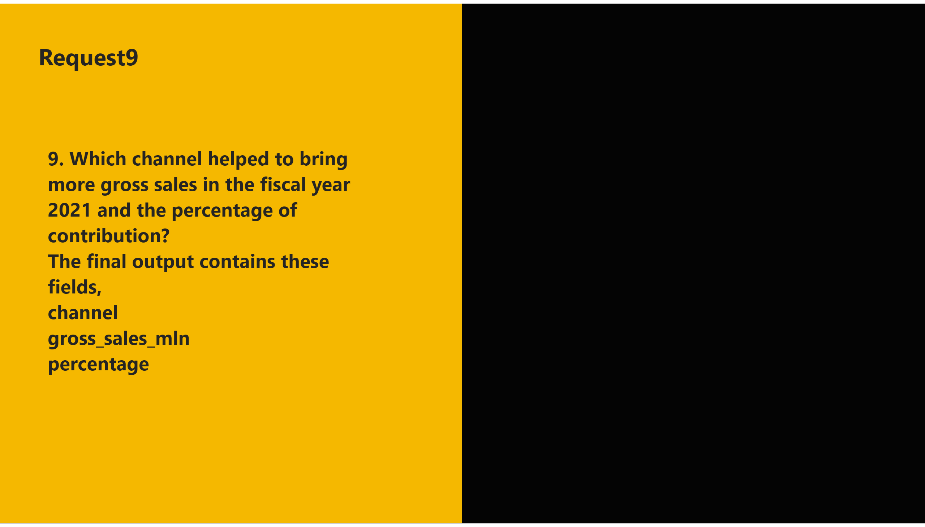
9
Notes:
shape
No alt text provided
textbox
No alt text provided
textbox
No alt text provided
shape
No alt text provided

Slide 35
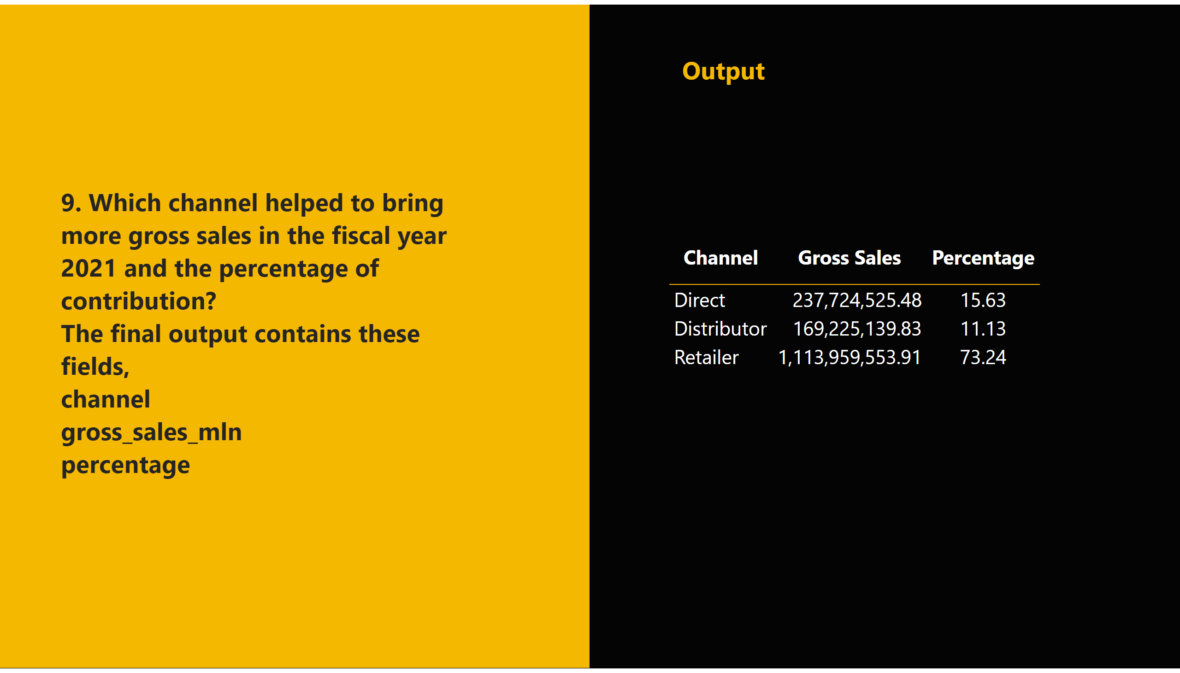
A9
Notes:
shape
No alt text provided
tableEx
No alt text provided
textbox
No alt text provided
textbox
No alt text provided
shape
No alt text provided

Slide 36
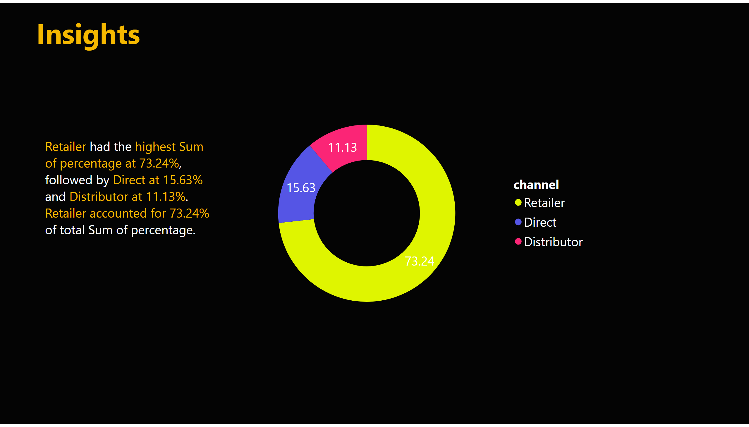
request9
Notes:
donutChart
No alt text provided
textbox
No alt text provided
textbox
No alt text provided

Slide 37
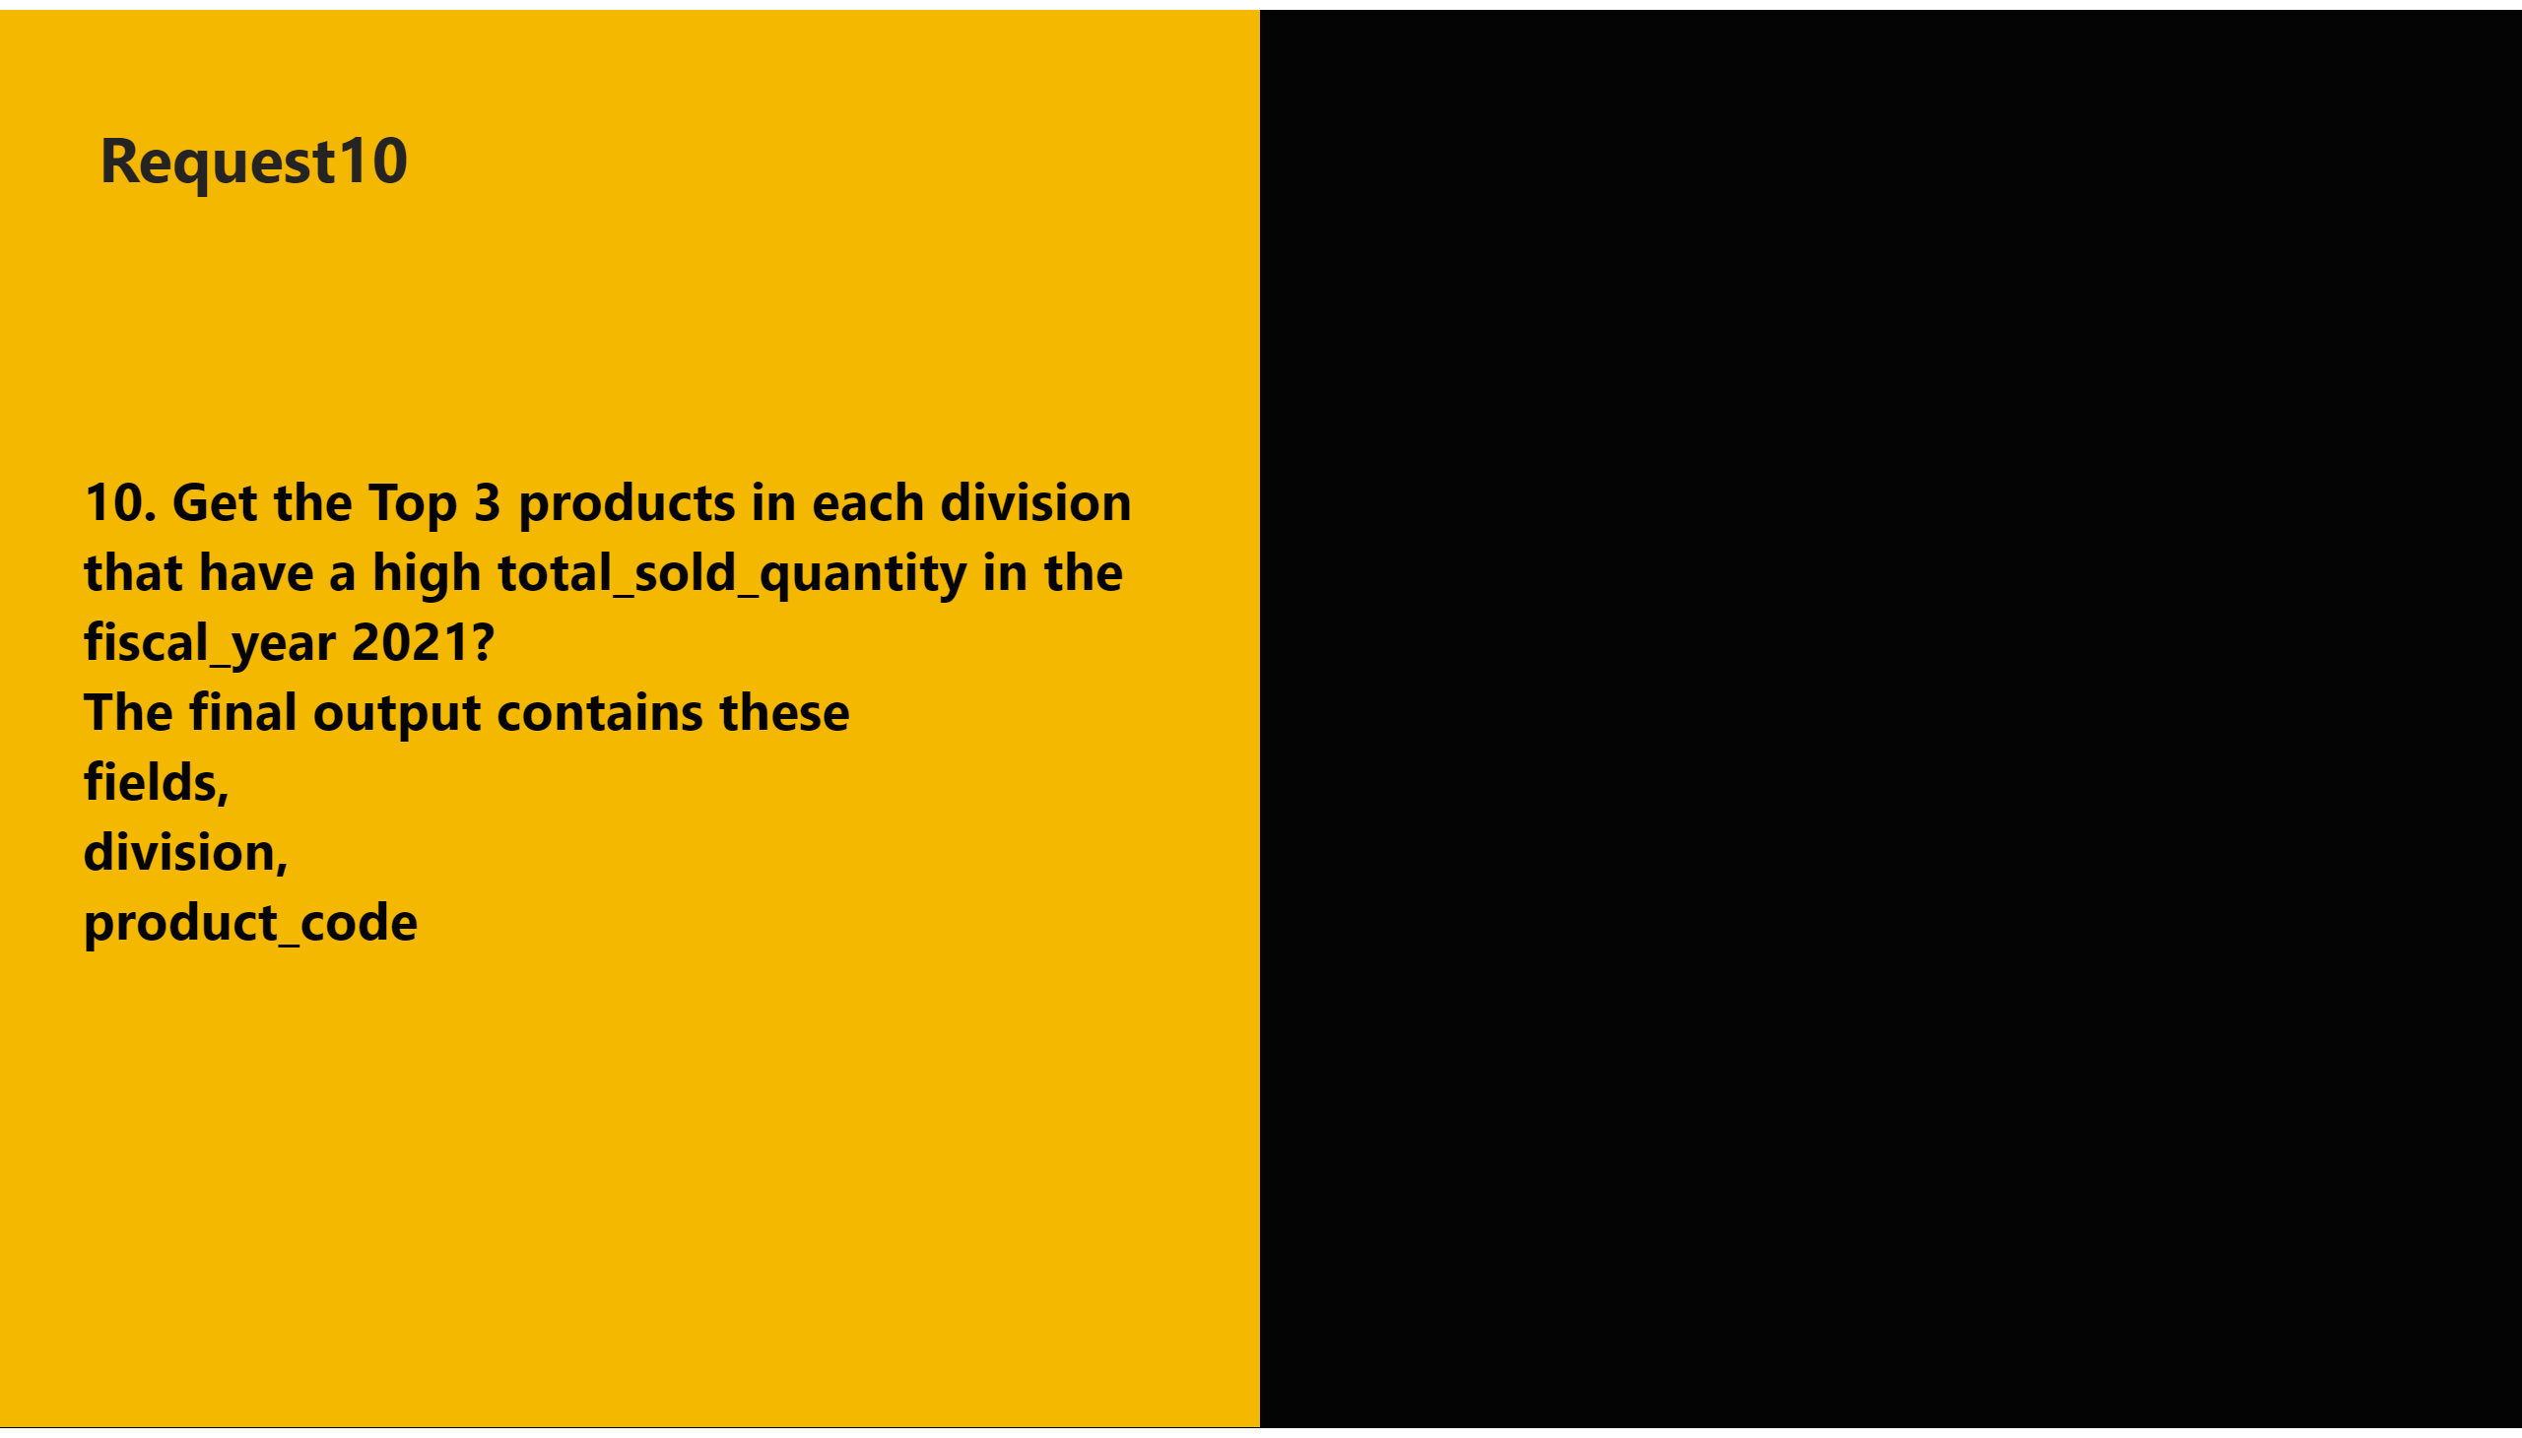
10
Notes:
shape
No alt text provided
textbox
No alt text provided
textbox
No alt text provided
shape
No alt text provided

Slide 38
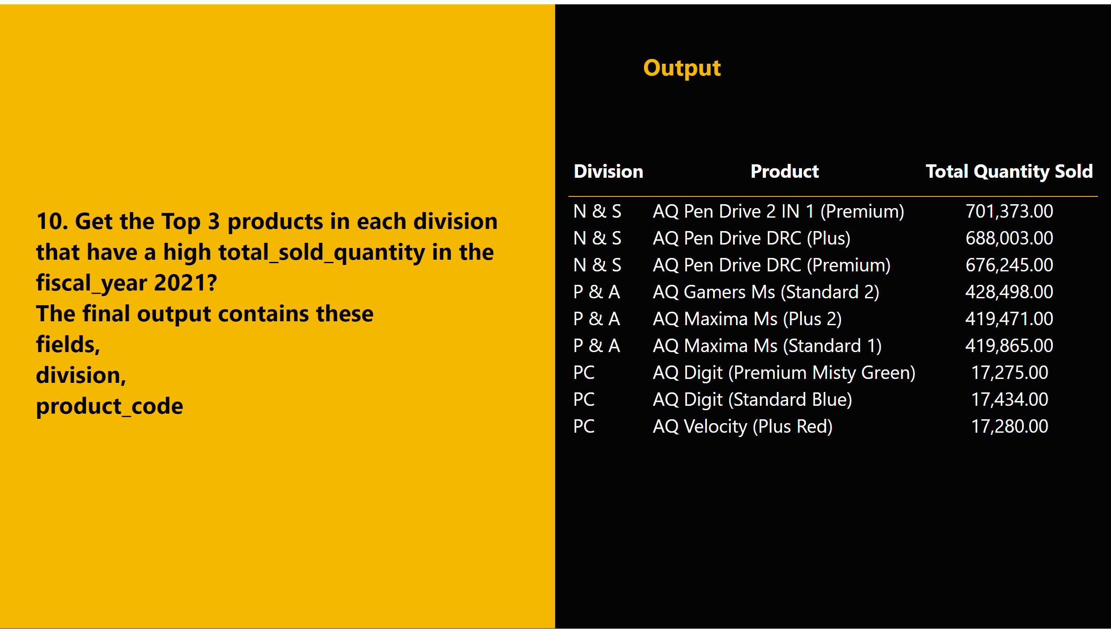
A10
Notes:
shape
No alt text provided
tableEx
No alt text provided
textbox
No alt text provided
textbox
No alt text provided
shape
No alt text provided

Slide 39
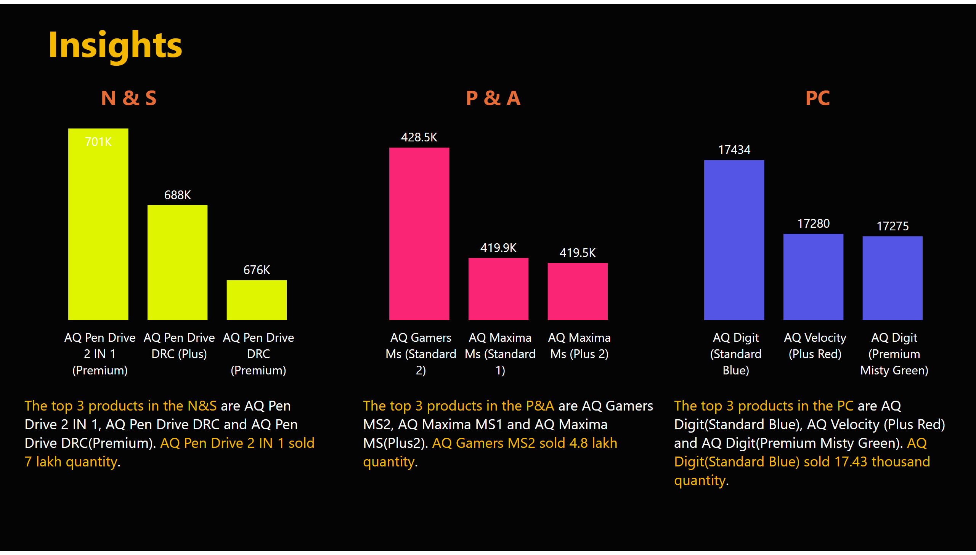
request10
Notes:
clusteredColumnChart
No alt text provided
clusteredColumnChart
No alt text provided
clusteredColumnChart
No alt text provided
textbox
No alt text provided
textbox
No alt text provided
textbox
No alt text provided
textbox
No alt text provided
textbox
No alt text provided
textbox
No alt text provided
textbox
No alt text provided

Slide 40

end
Notes:
shape
No alt text provided
textbox
No alt text provided
textbox
No alt text provided
shape
No alt text provided
shape
No alt text provided
shape
No alt text provided
textbox
No alt text provided
shape
No alt text provided
textbox
No alt text provided
shape
No alt text provided
textbox
No alt text provided
shape
No alt text provided
shape
No alt text provided
shape
No alt text provided
textbox
No alt text provided
textbox
No alt text provided
shape
No alt text provided
textbox
No alt text provided
textbox
No alt text provided
shape
No alt text provided
textbox
No alt text provided

